Slide 1
Grace-filled Memories
Mummy’s 70th Birthday

Slide 2
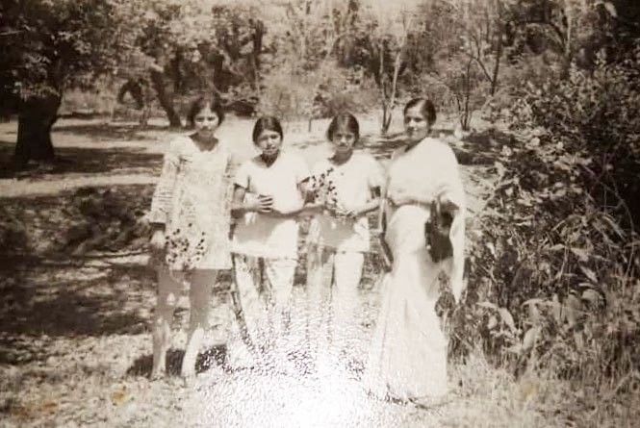
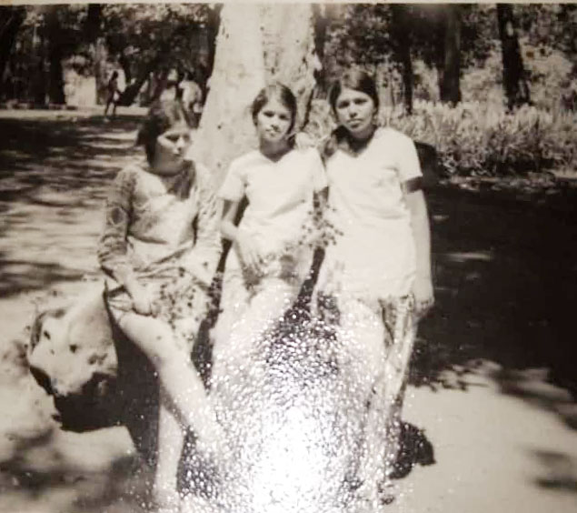
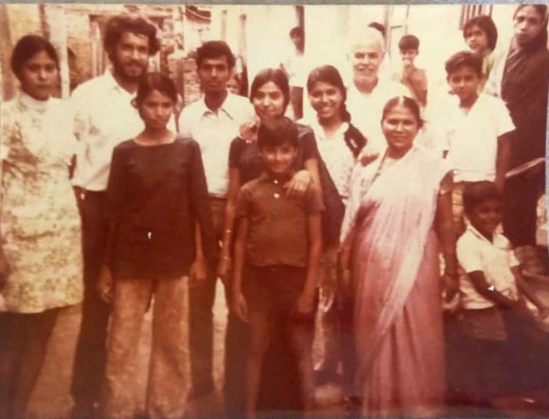
Beginnings (The D’souza Clan)

Slide 3
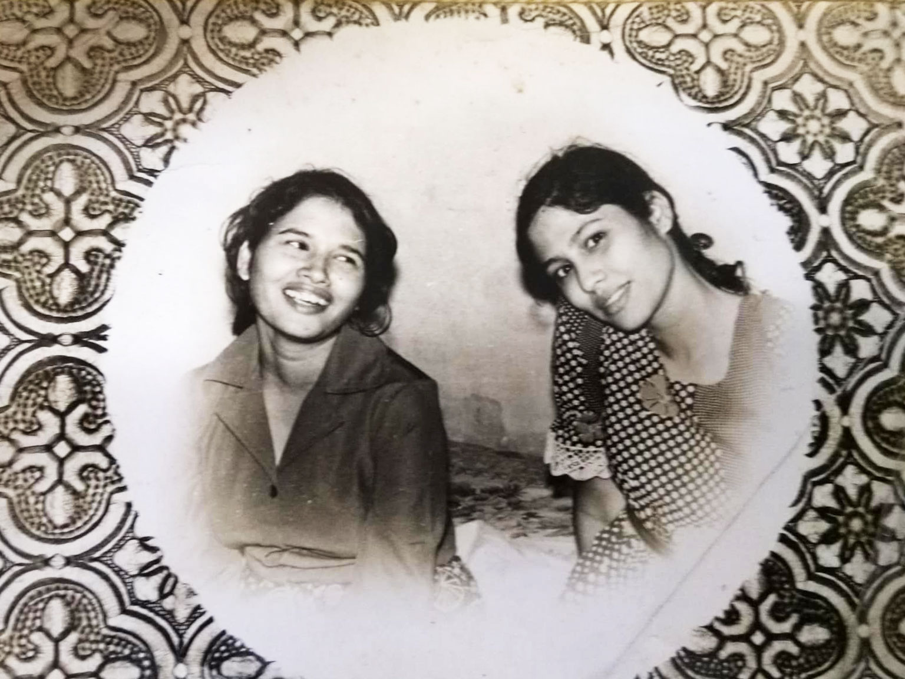
Heart Breakers (Featuring Leena & Keren)

Slide 4
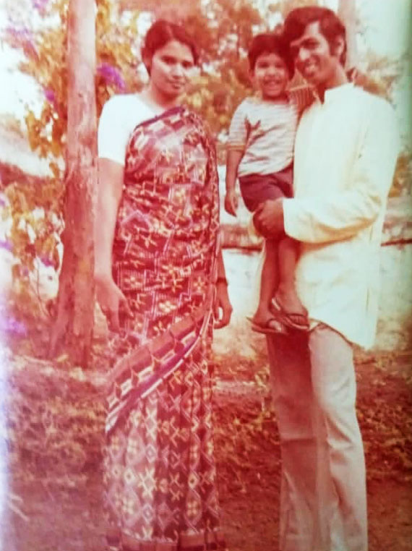
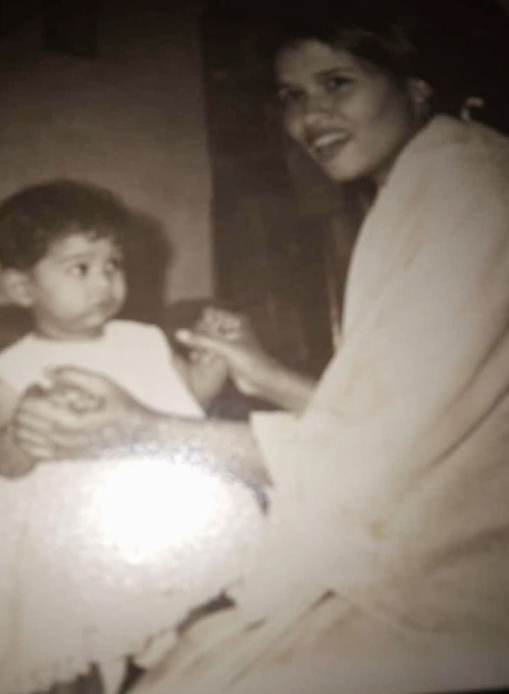
New Beginnings (Chris and Sammy )

Slide 5
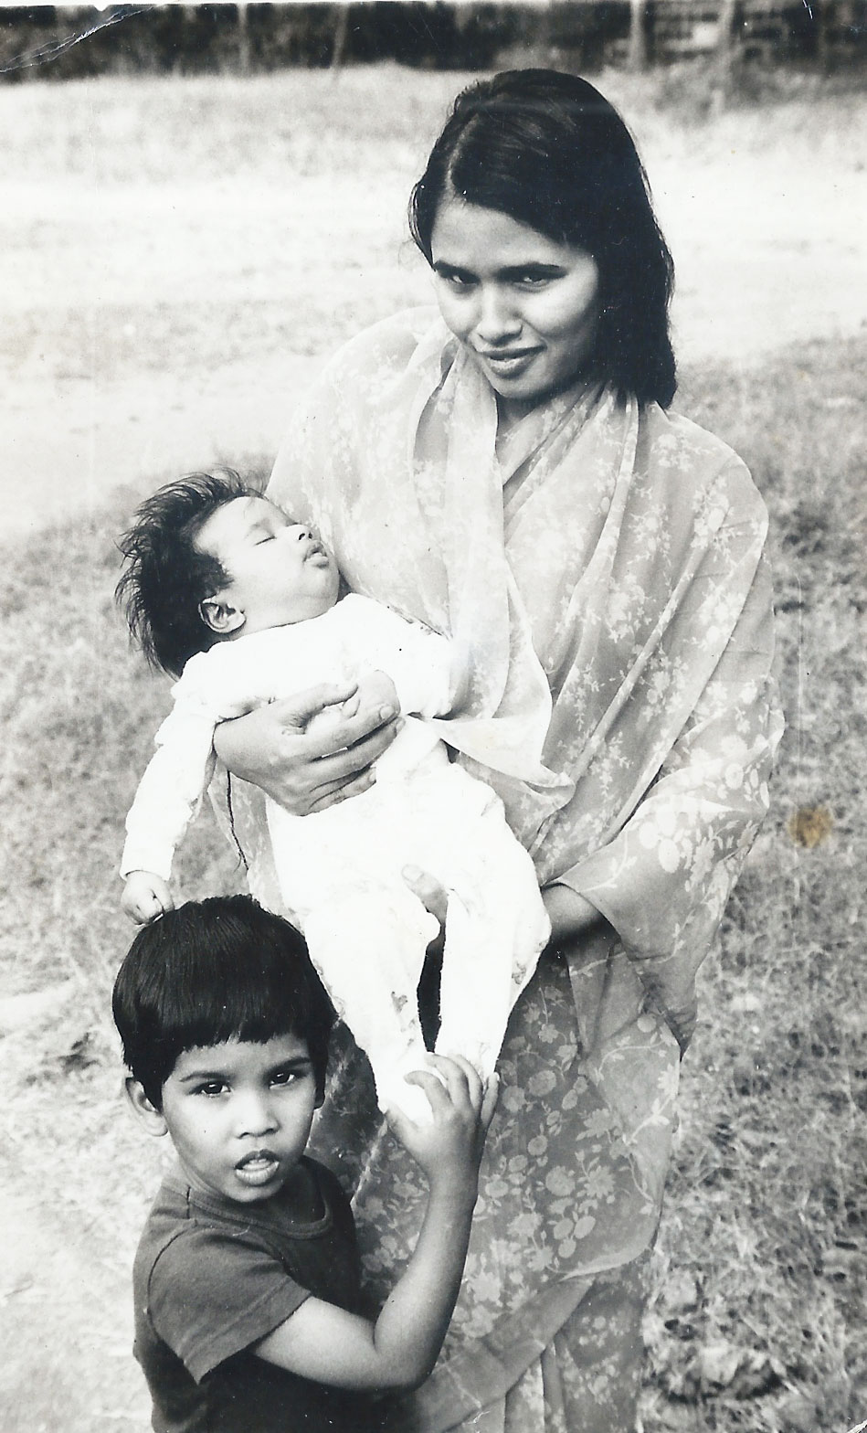
Look, My Hands are Full (Sammy & Baby Stephen)

Slide 6
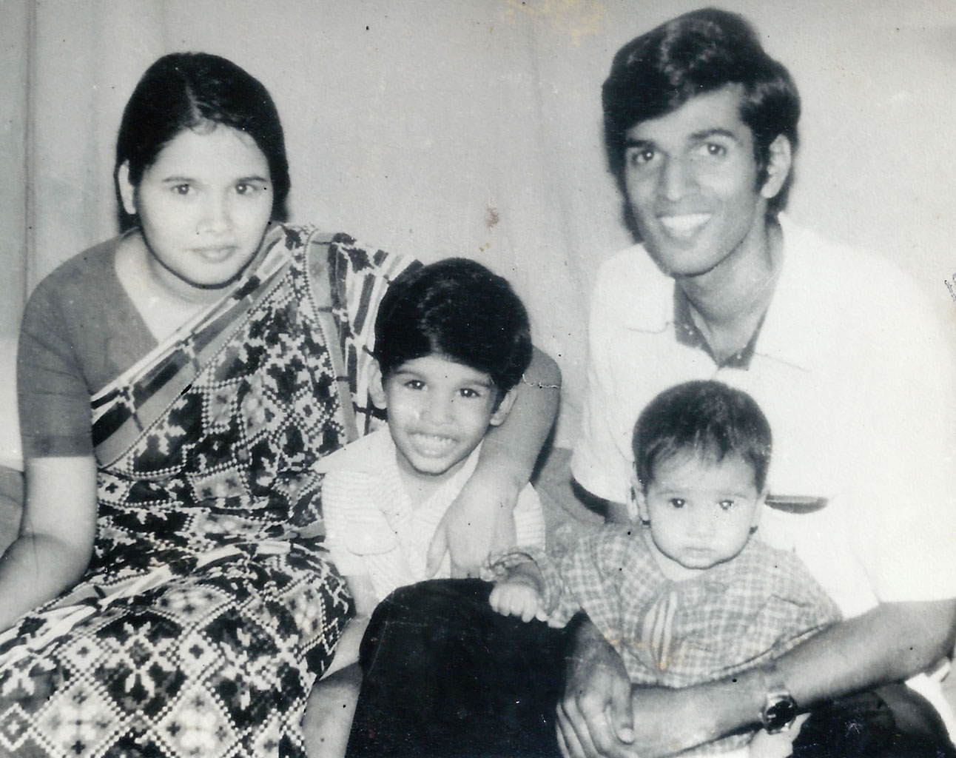
Calm before the little Storm

Slide 7
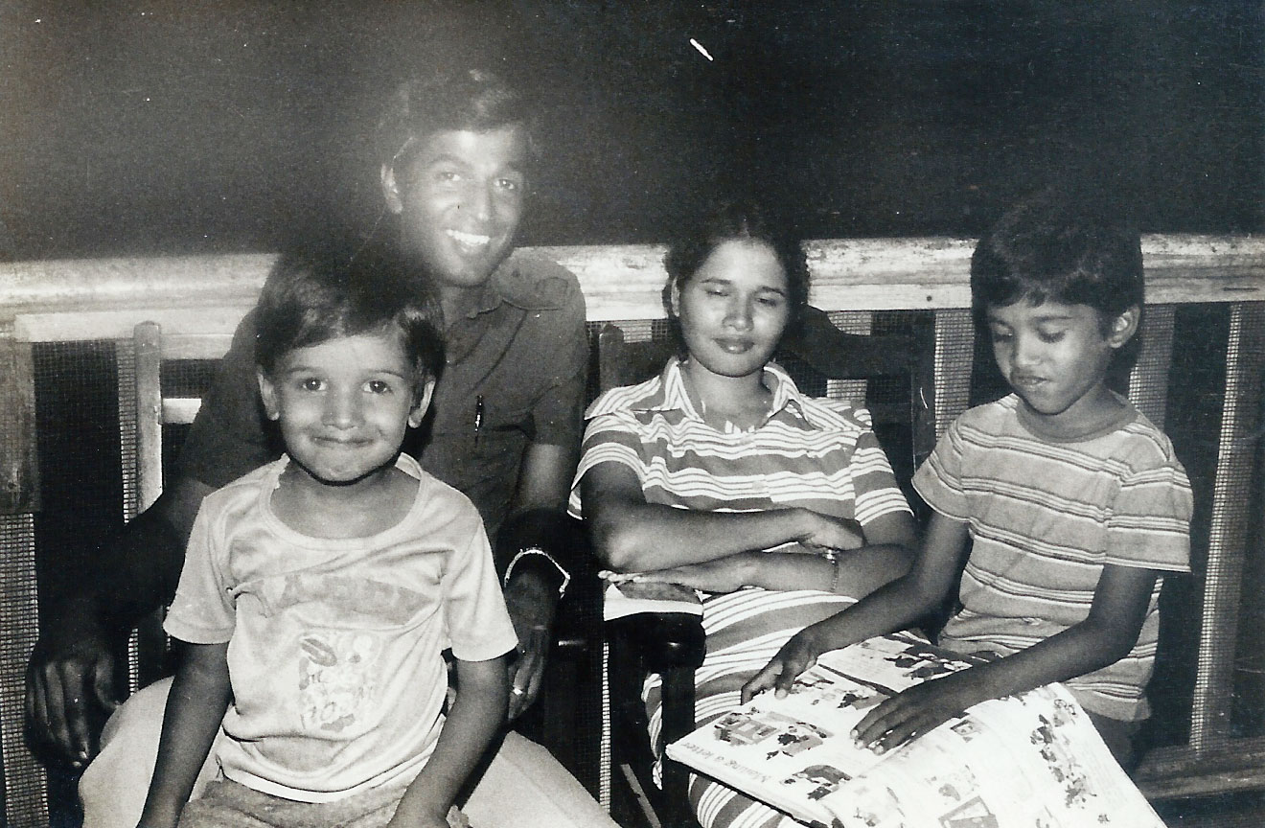
Sammy: Books Stephen: Looks

Slide 8
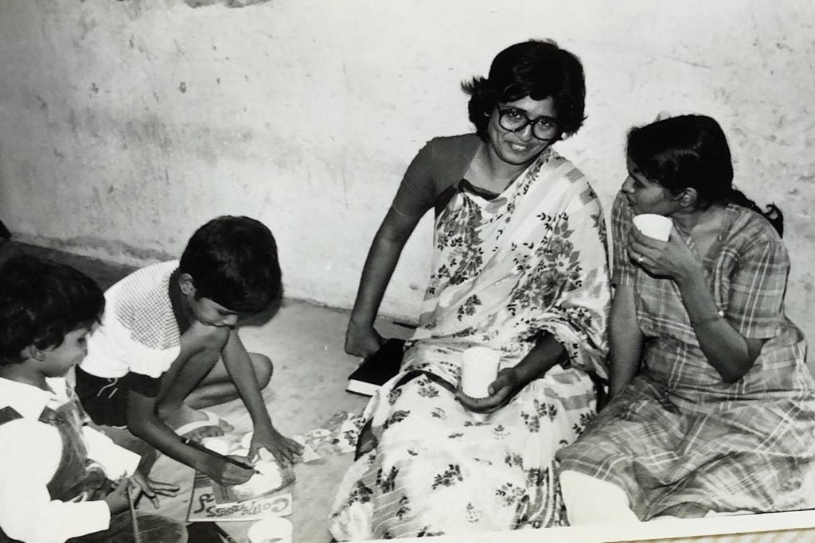
Lifelong Friends (with Carol)

Slide 9
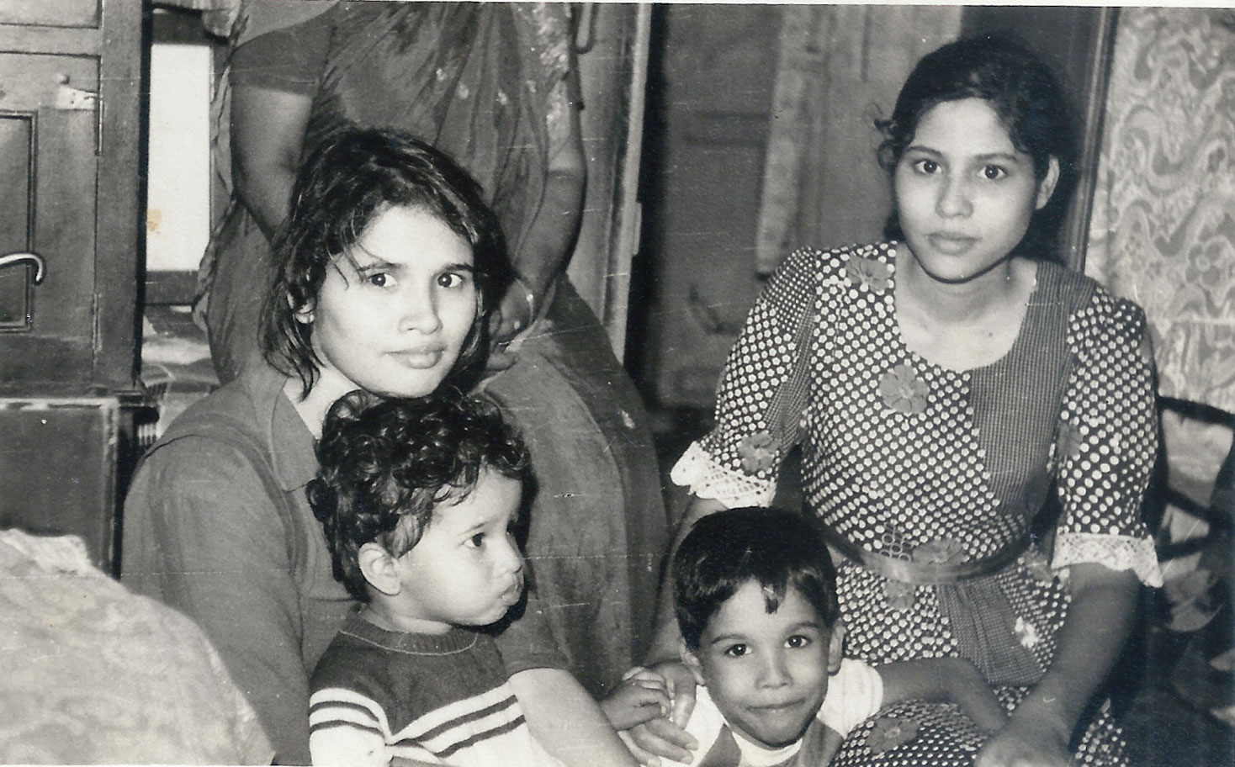
Faithful Helper (with Keren)

Slide 10
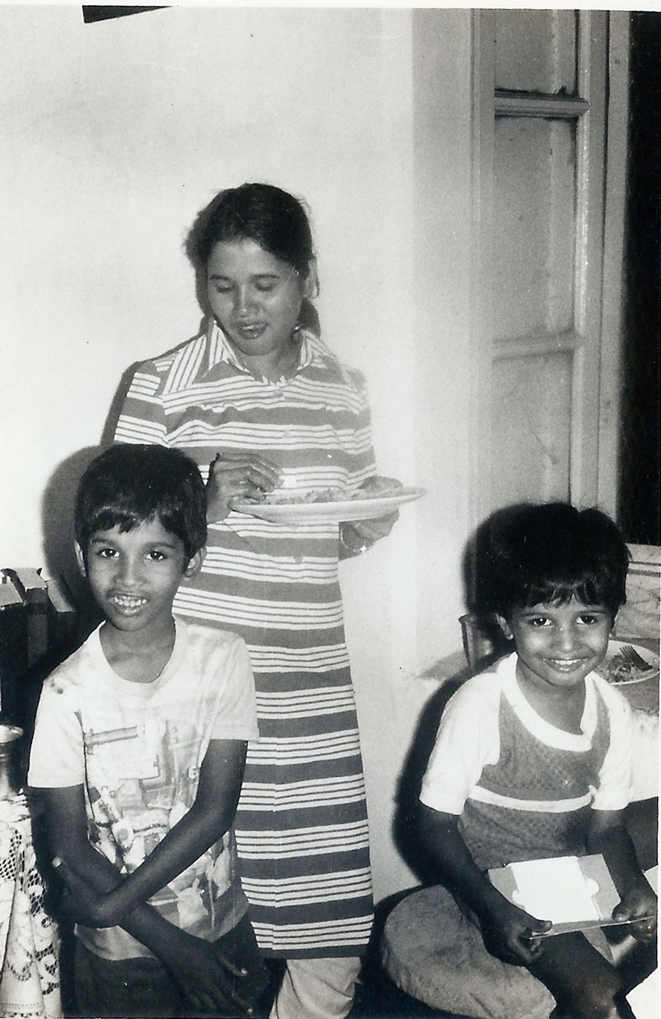
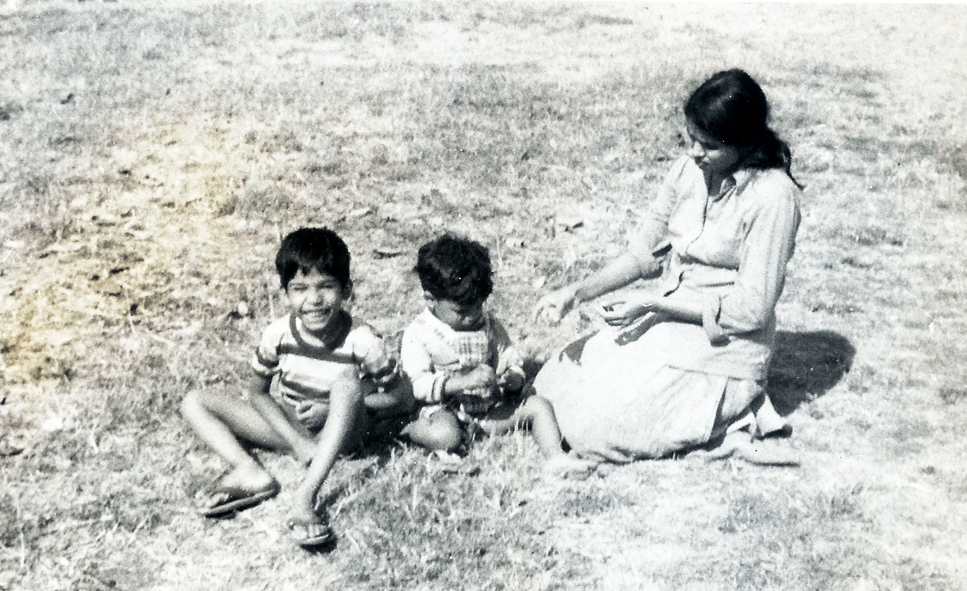
It takes a strong Woman (to handle Sammy & Stephen)

Slide 11
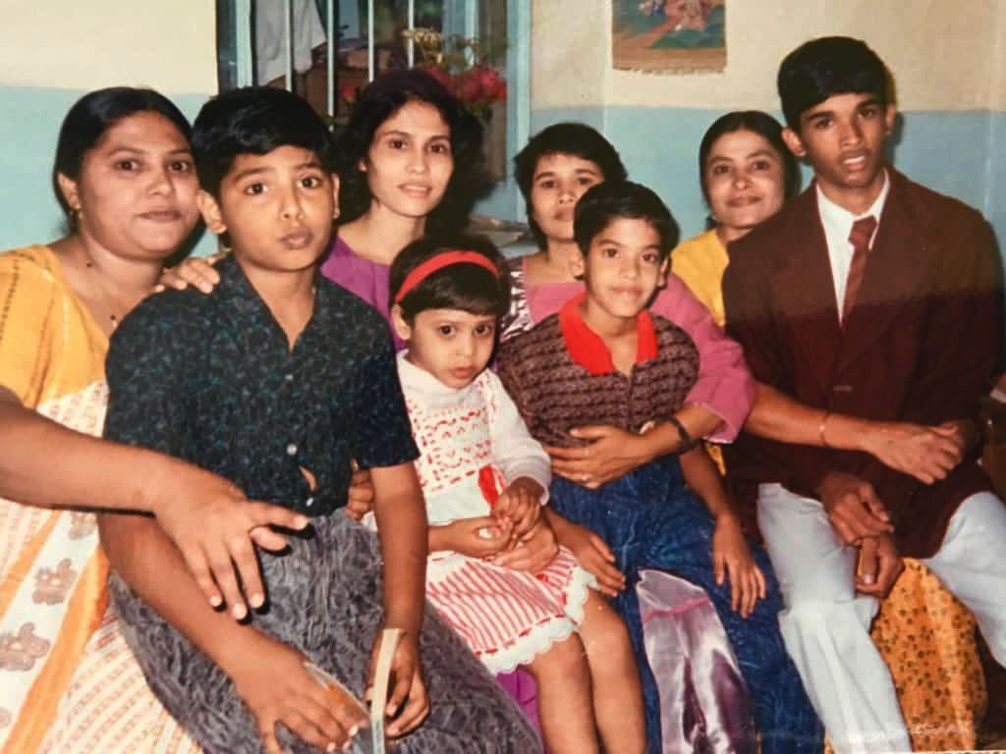
Cousins! (Summers at Stavely Road)

Slide 12
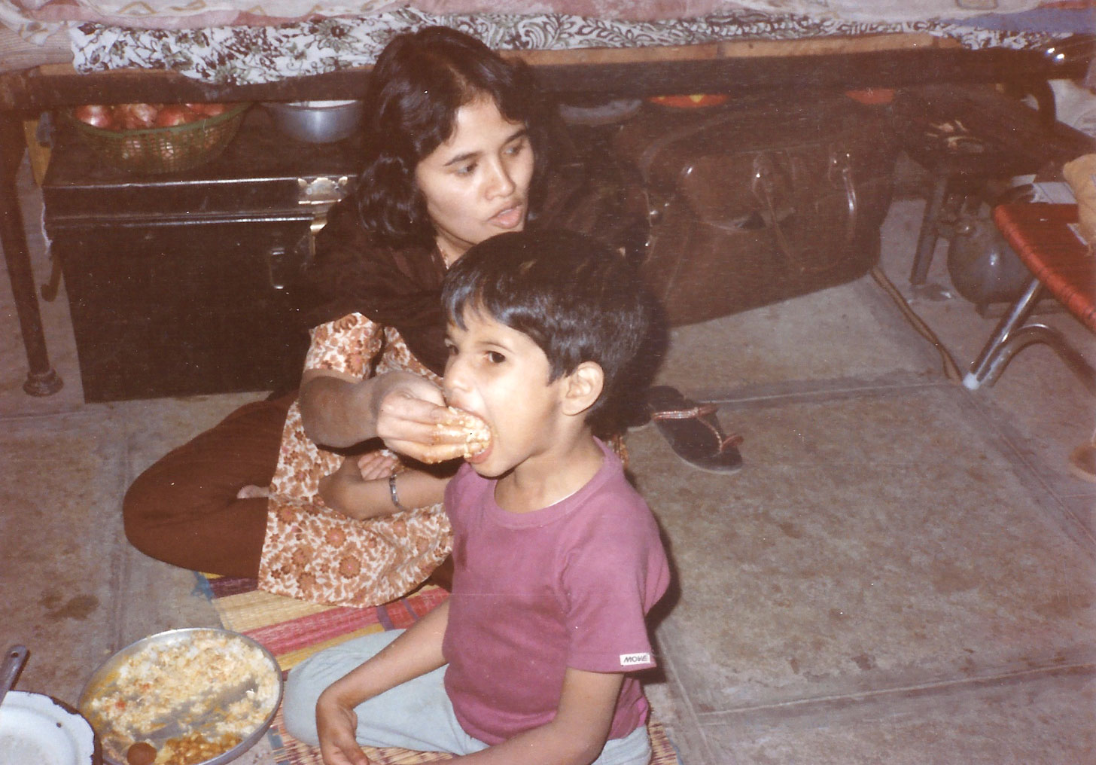
Hands-In Parenting (at Quartergate house)

Slide 13
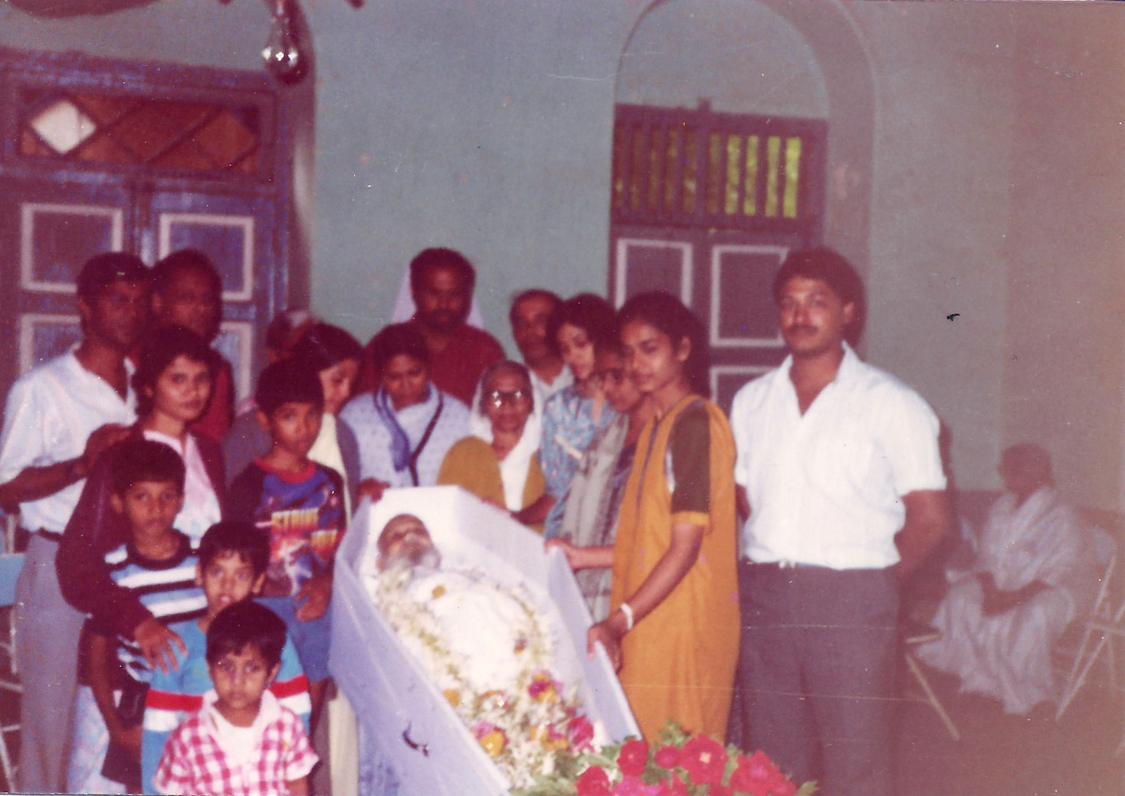
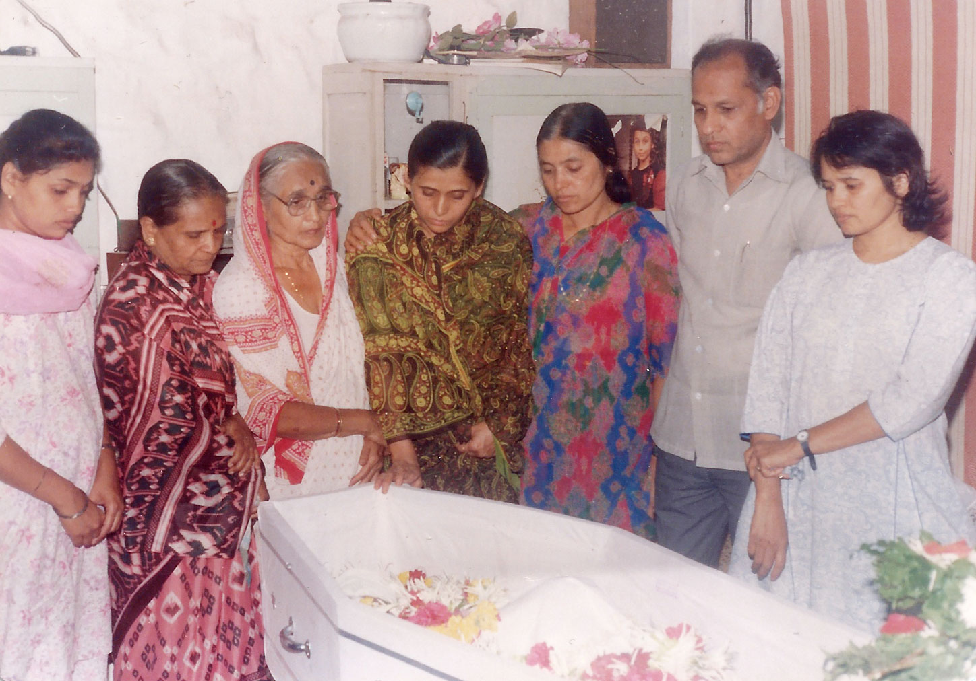
United in Tragedy (Papa and Shirish Funerals)

Slide 14
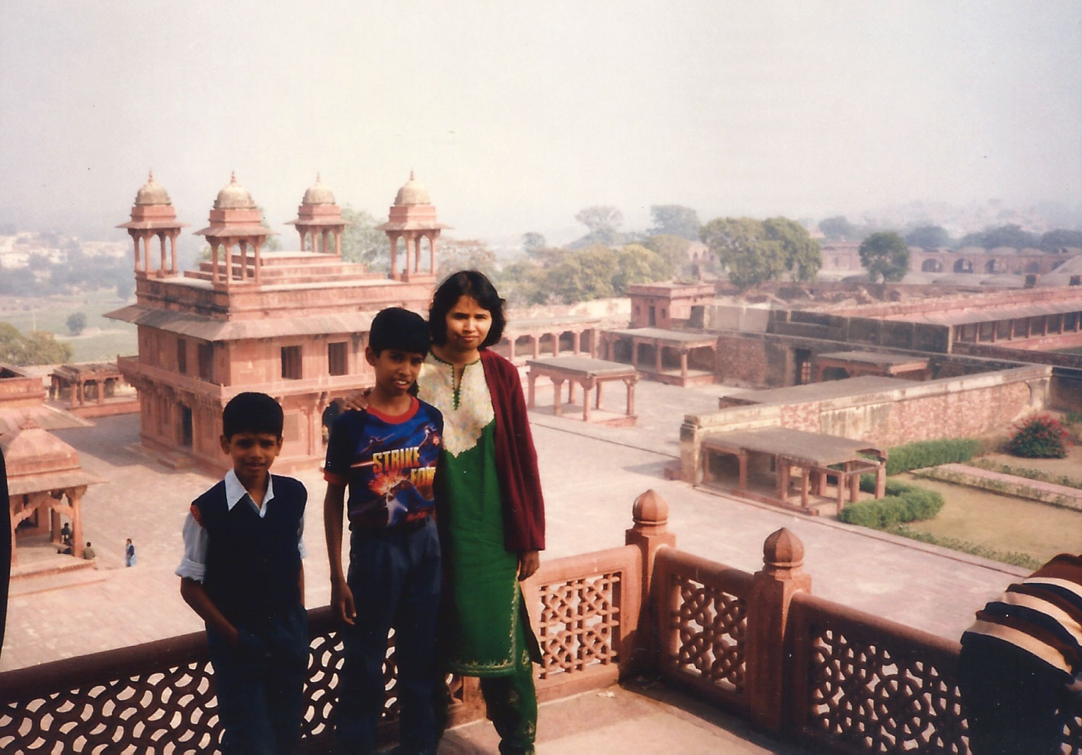
Adventures! (trip to Delhi/Jalandar with Kaushals)

Slide 15
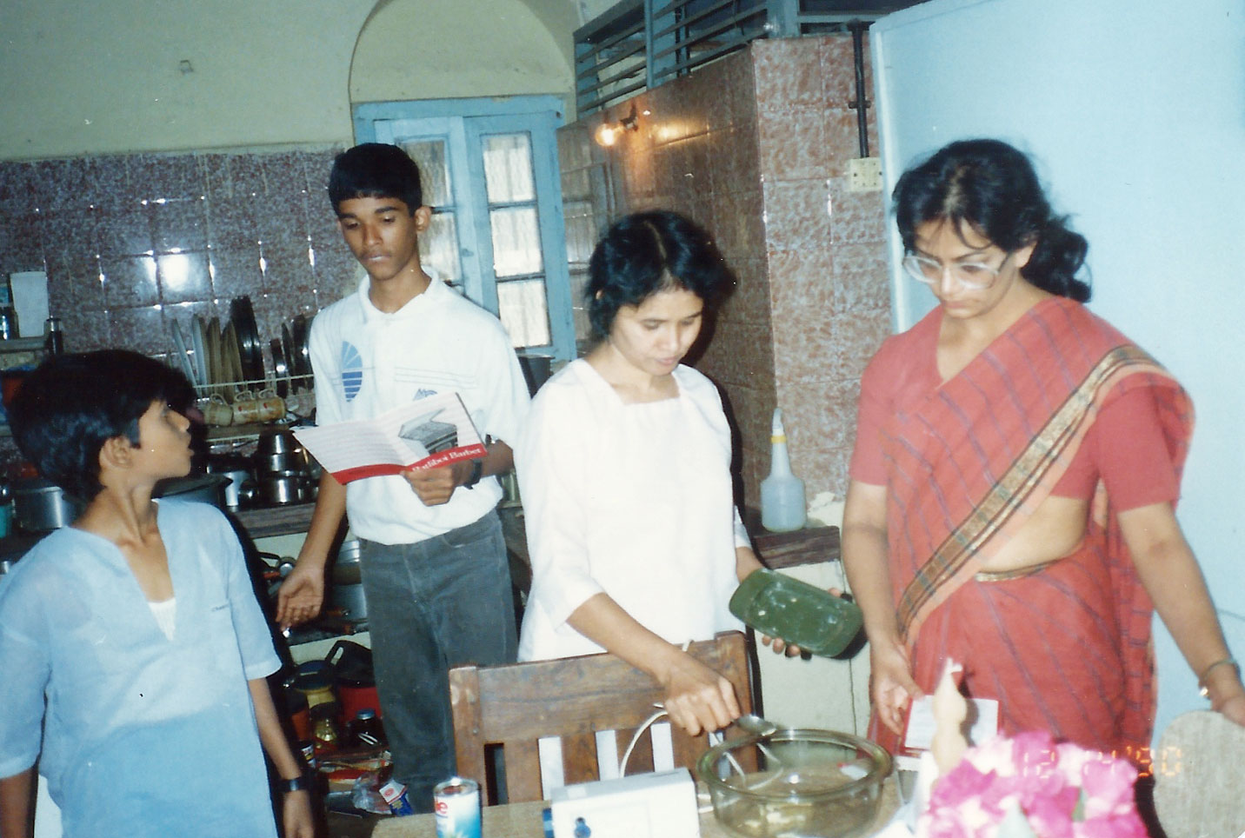
Best Birthdays Ever! (with Anu at Stavely Rd.)

Slide 16
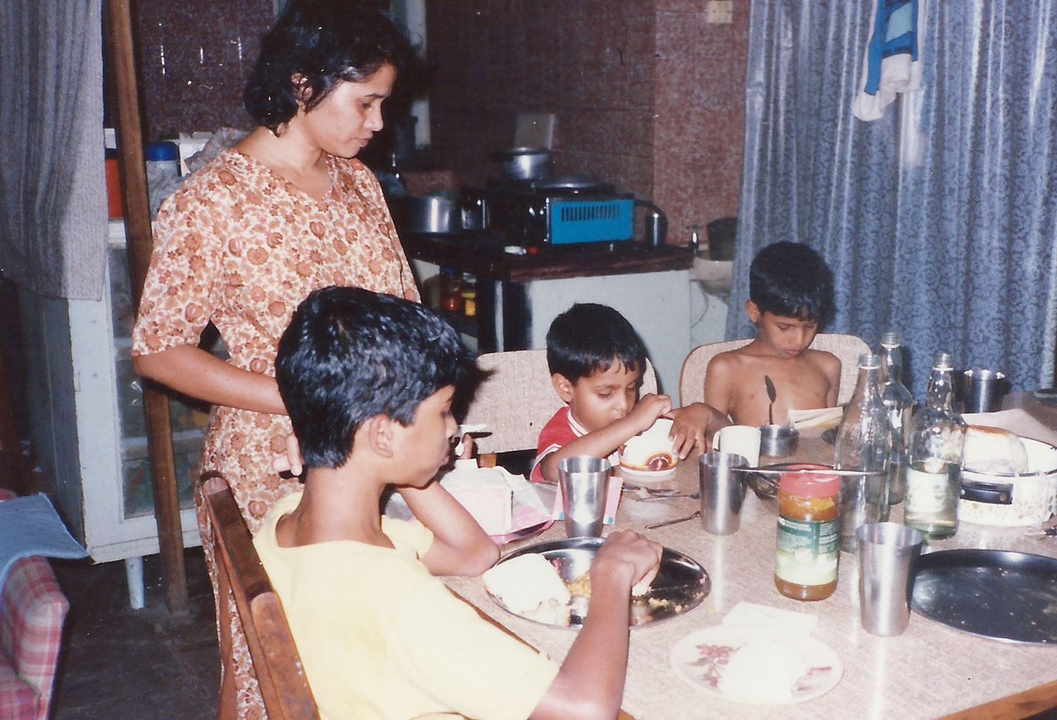
Best Food in Town (but Rohit chose to sleep through it)

Slide 17
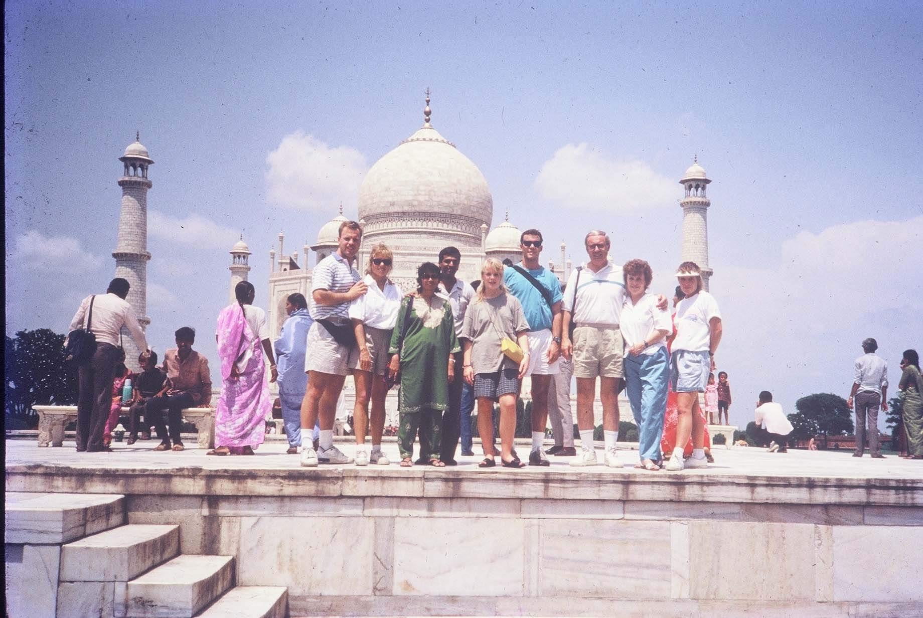
Wonders of the World (With MacArthurs at Taj Mahal)

Slide 18
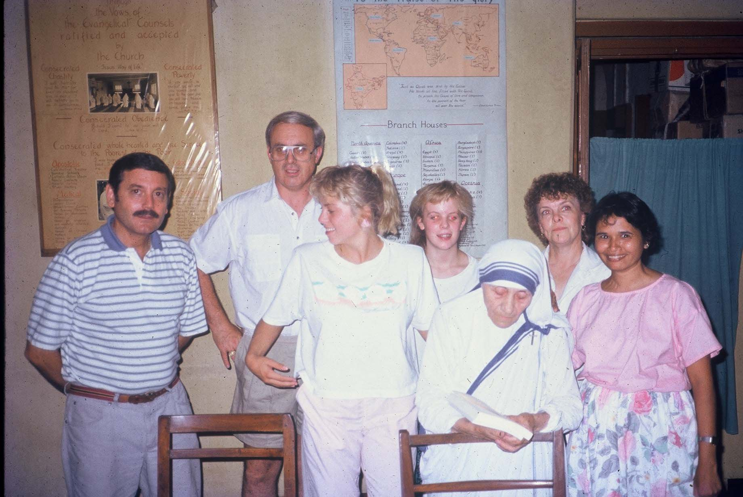
Did She Read it? (Giving the Gospel to Mother Teresa)

Slide 19
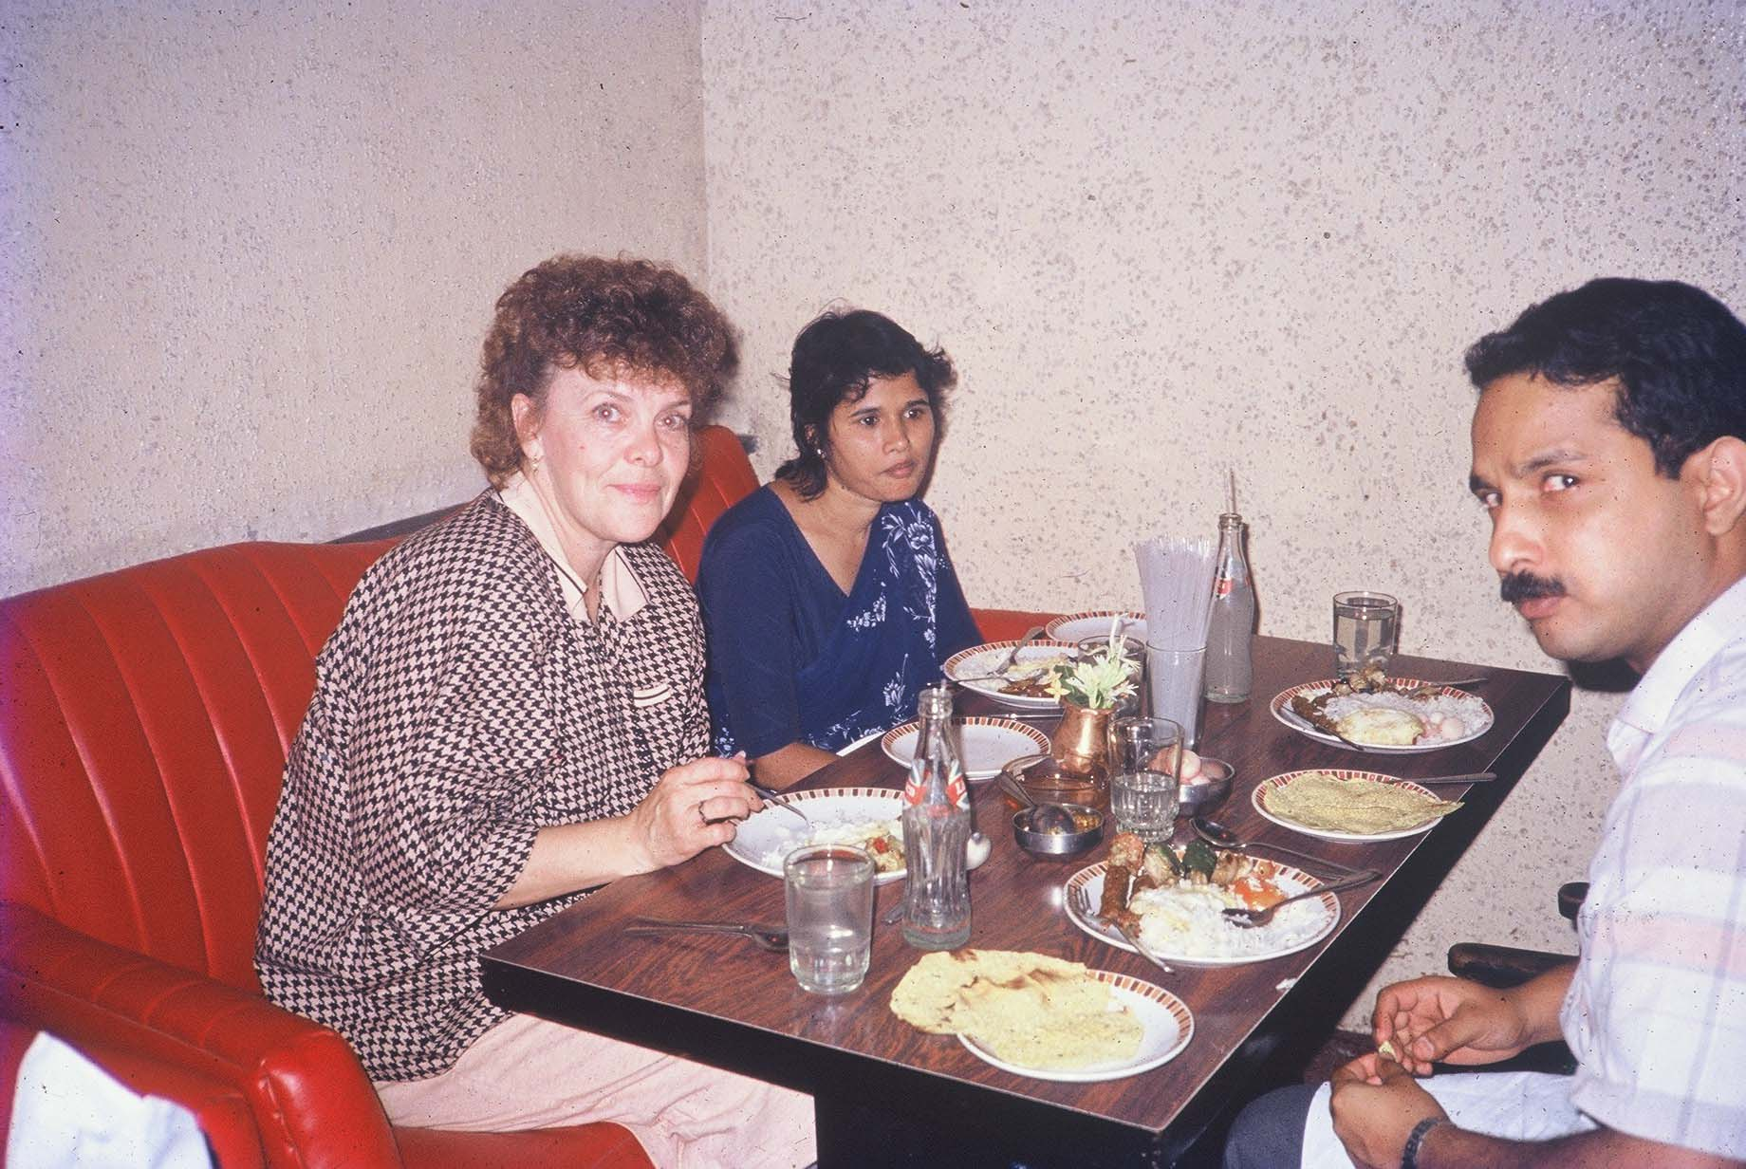
Behind Every Strong Man… (with Pat MacArthur and understandably worried Dev Sarkar)

Slide 20
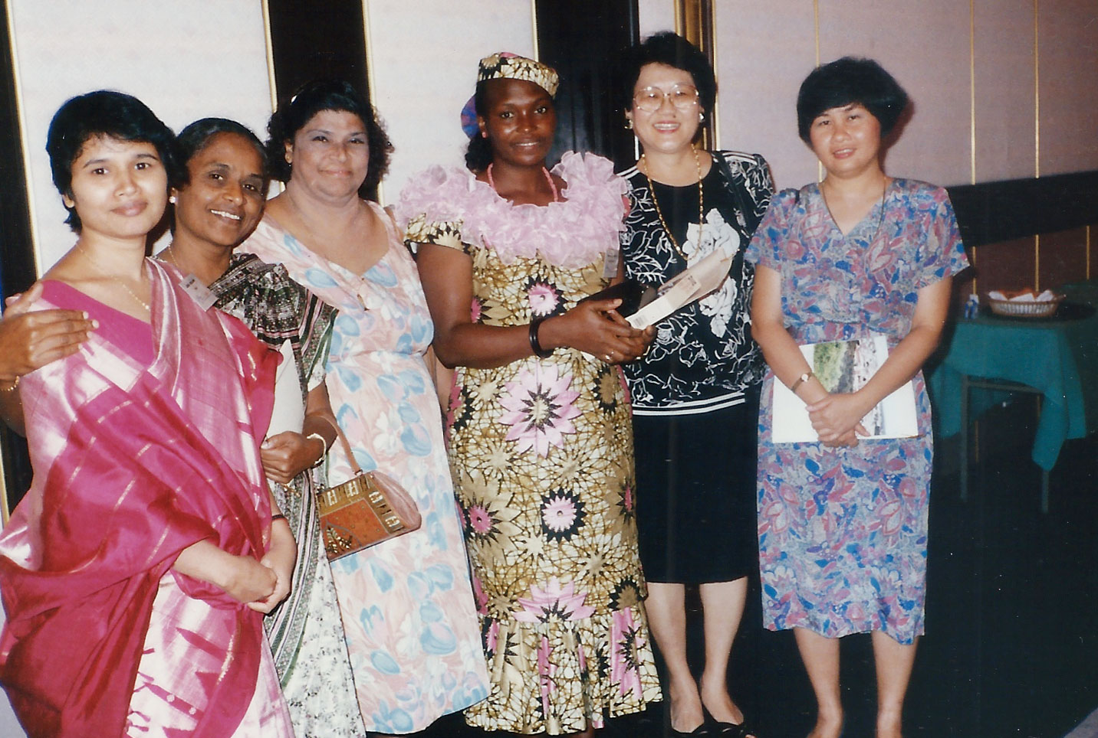
Singapore! (the Lady Prophetesses of Haggai Inst.)

Slide 21
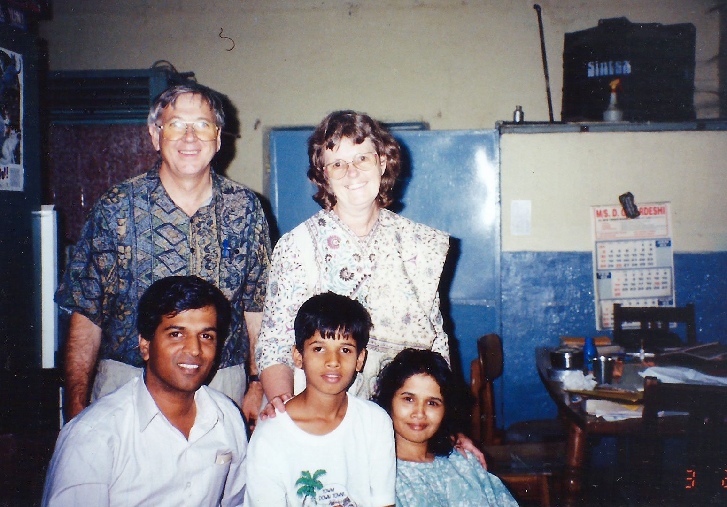
Partners in Ministry (John and Val Main)

Slide 22
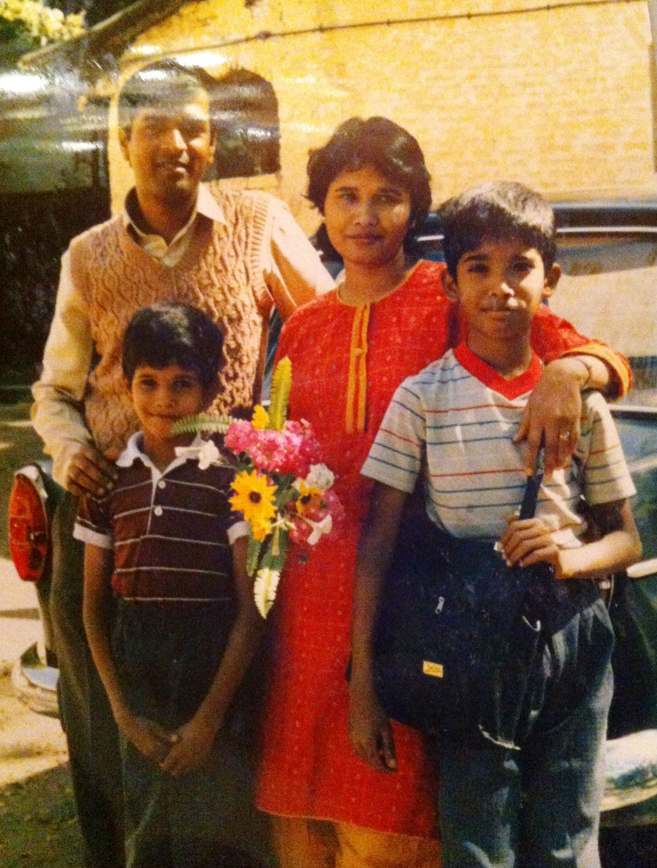
And Time Marches On …

Slide 23
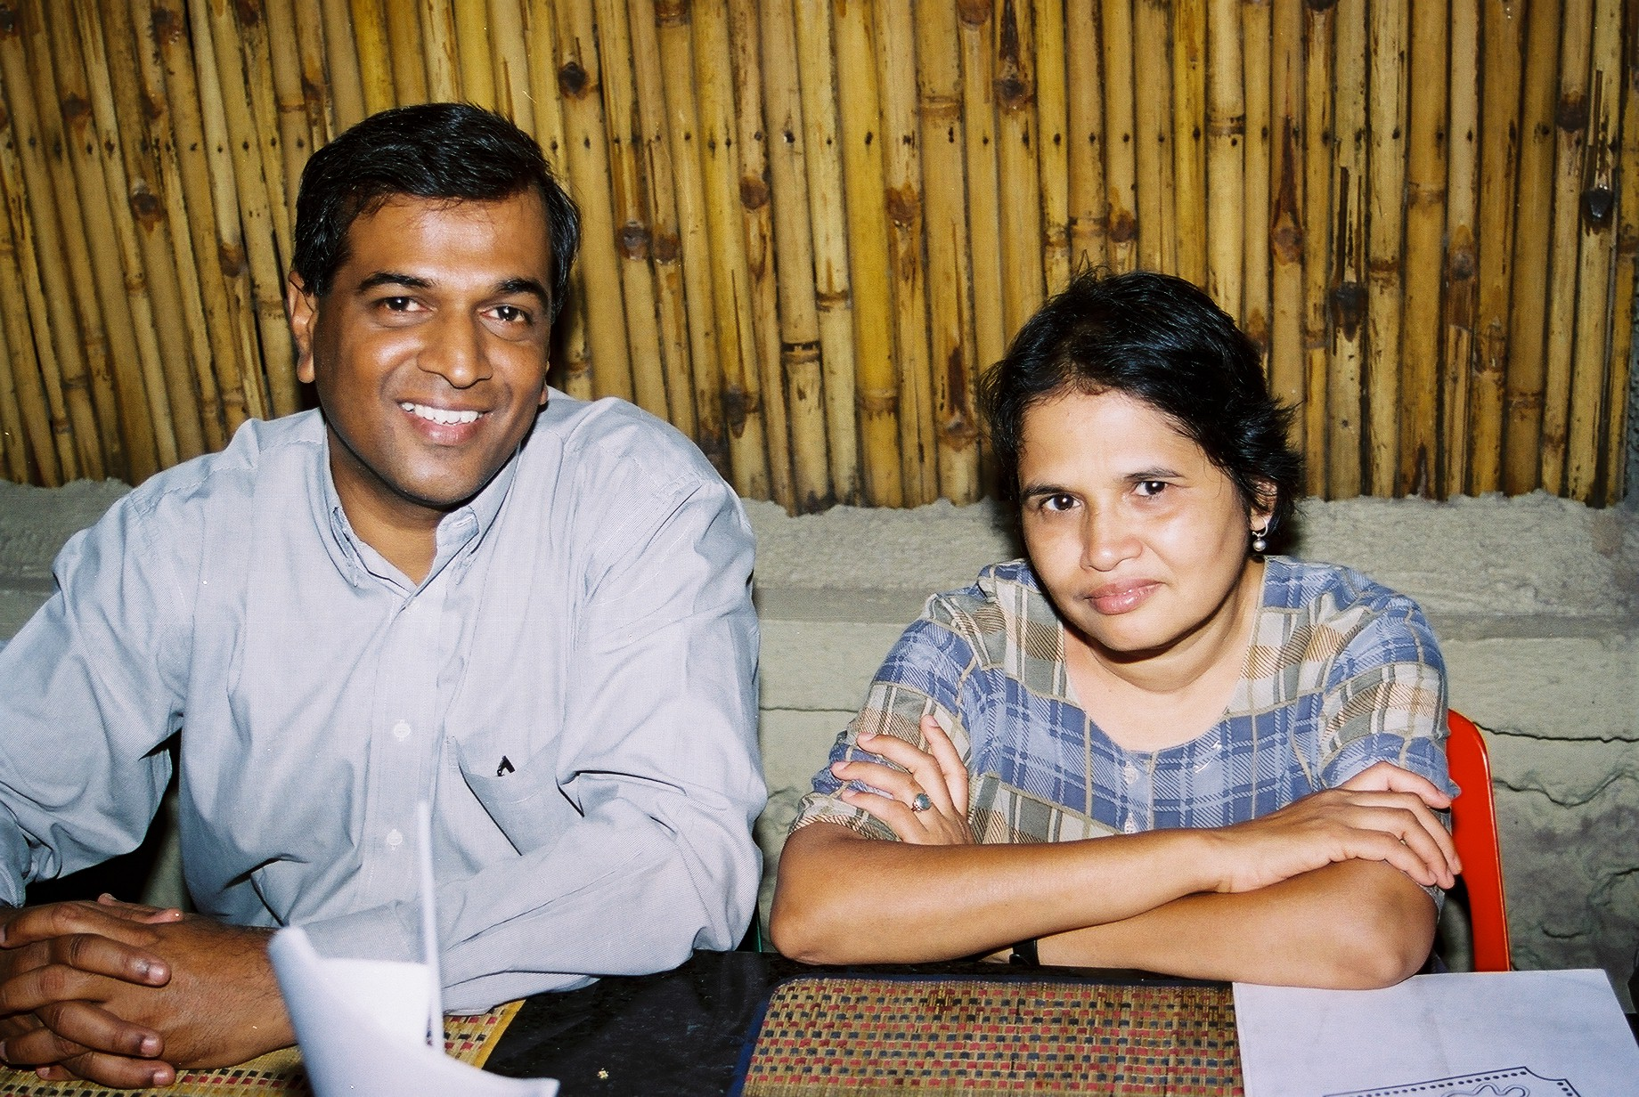

Slide 24
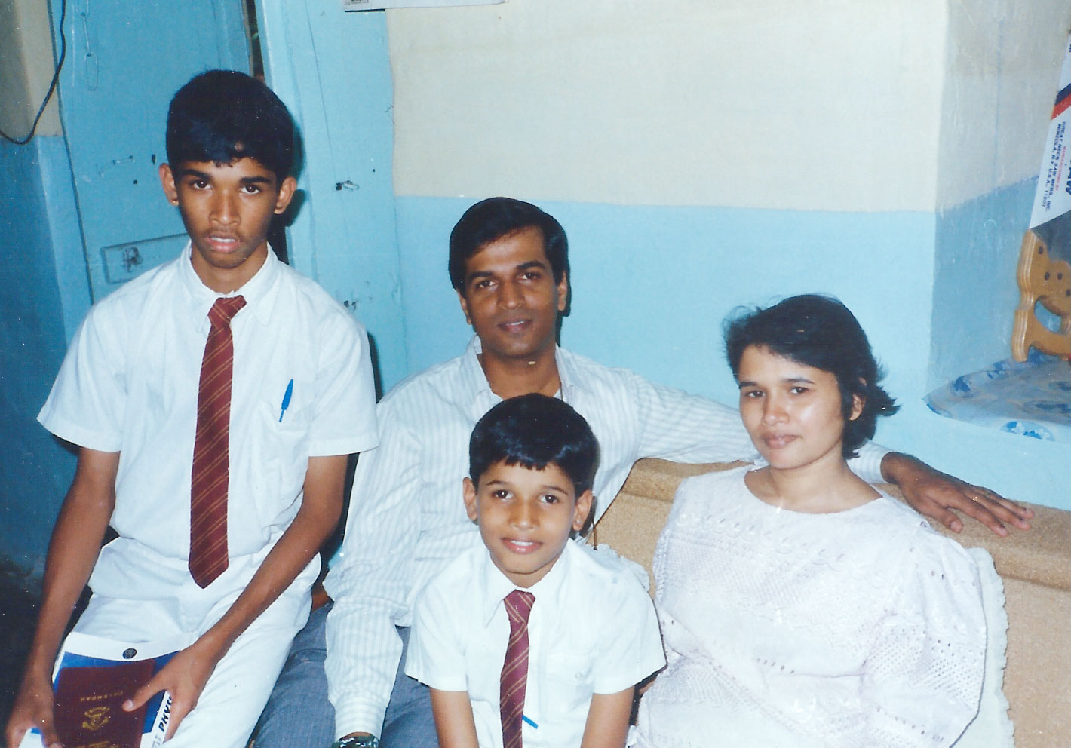

Slide 25
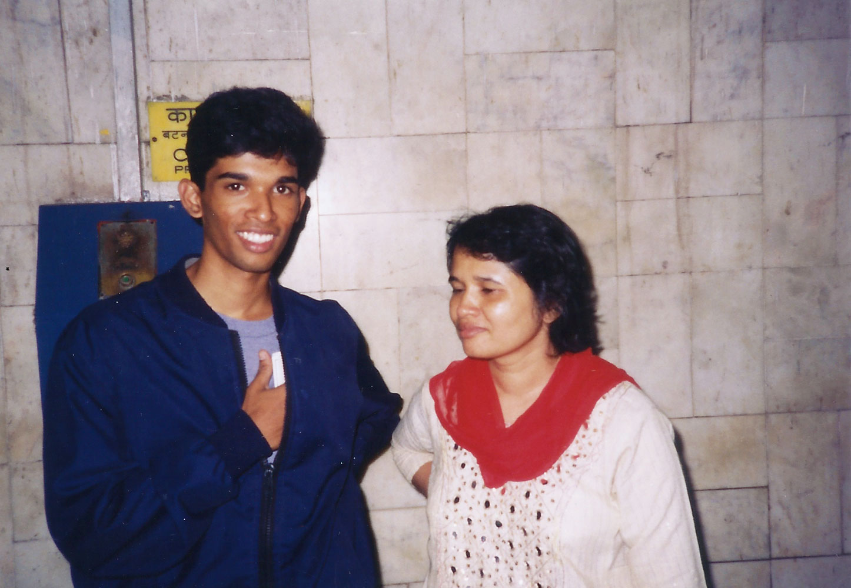
Time Marches On (The Chosen Son Leaves for College)

Slide 26
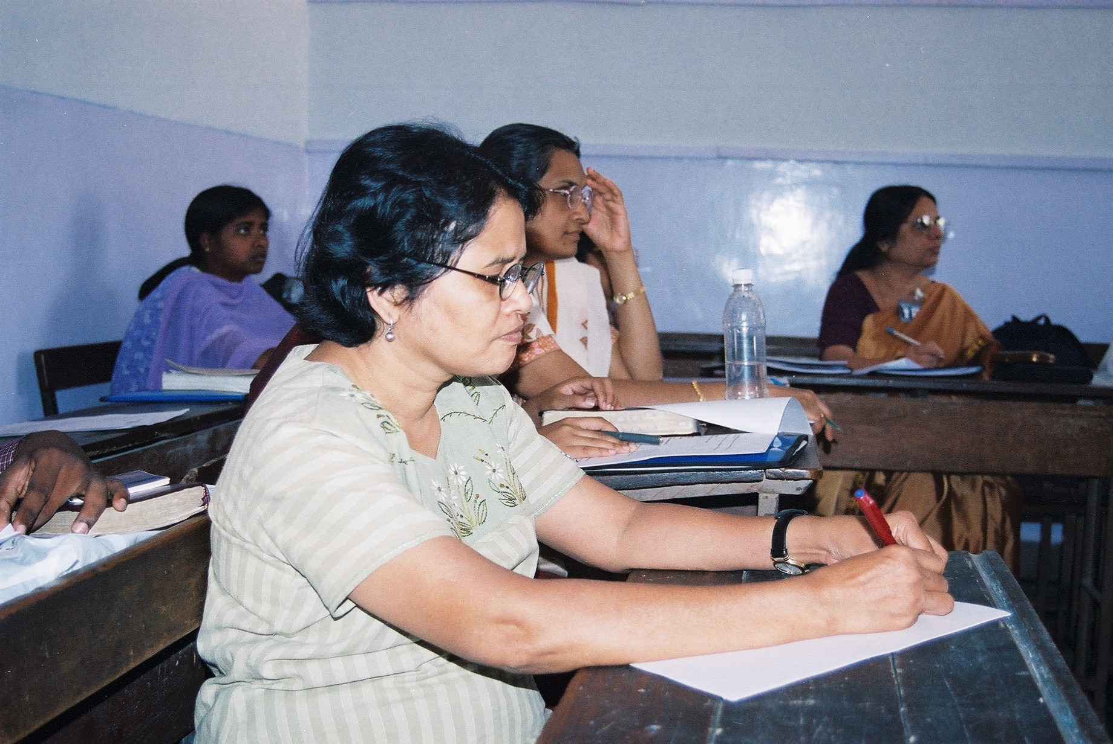
Always Learning (DCC 25th Anniversary)

Slide 27
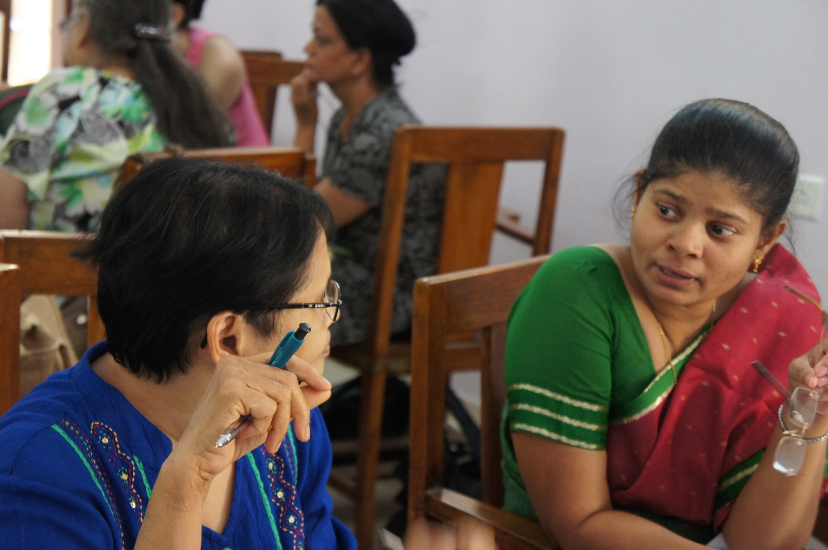
Always Teaching (DCC 25th Anniversary)

Slide 28
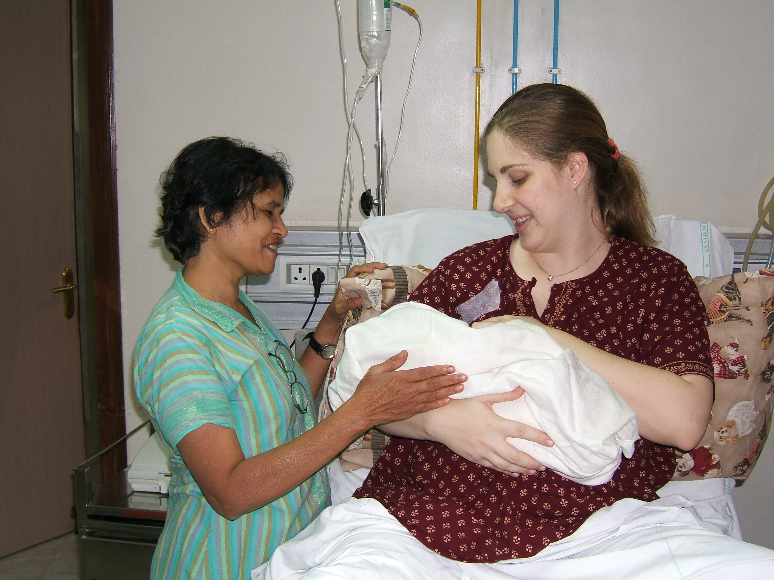
A New Phase of Life (Hannah is Born)

Slide 29
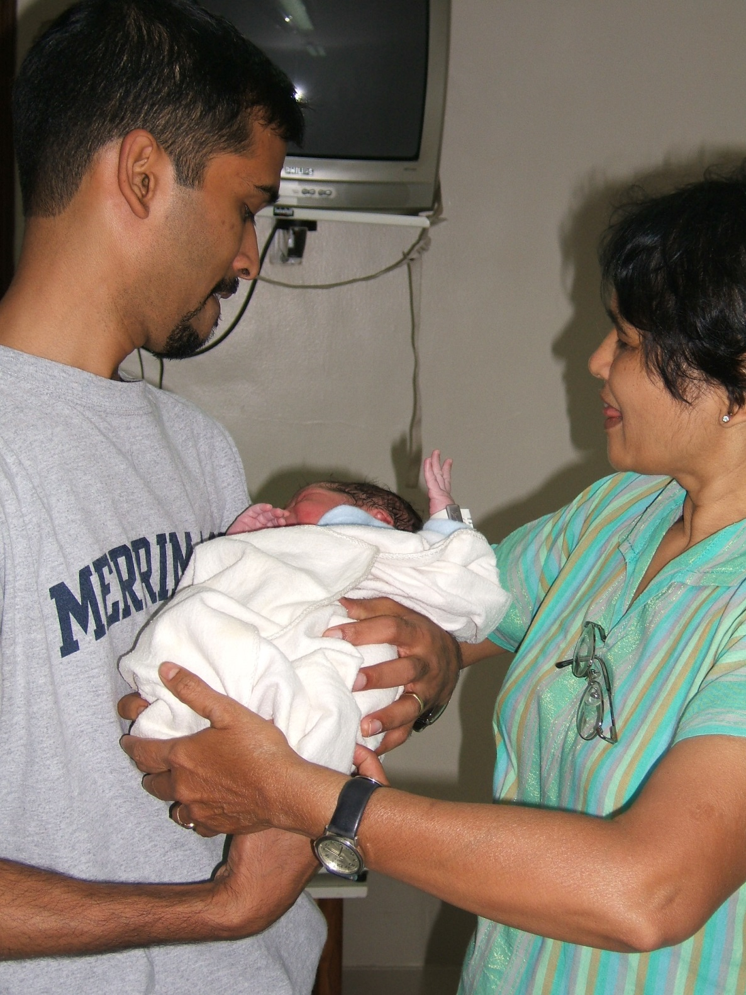
Passing the Baton (Proud Grandmother)

Slide 30
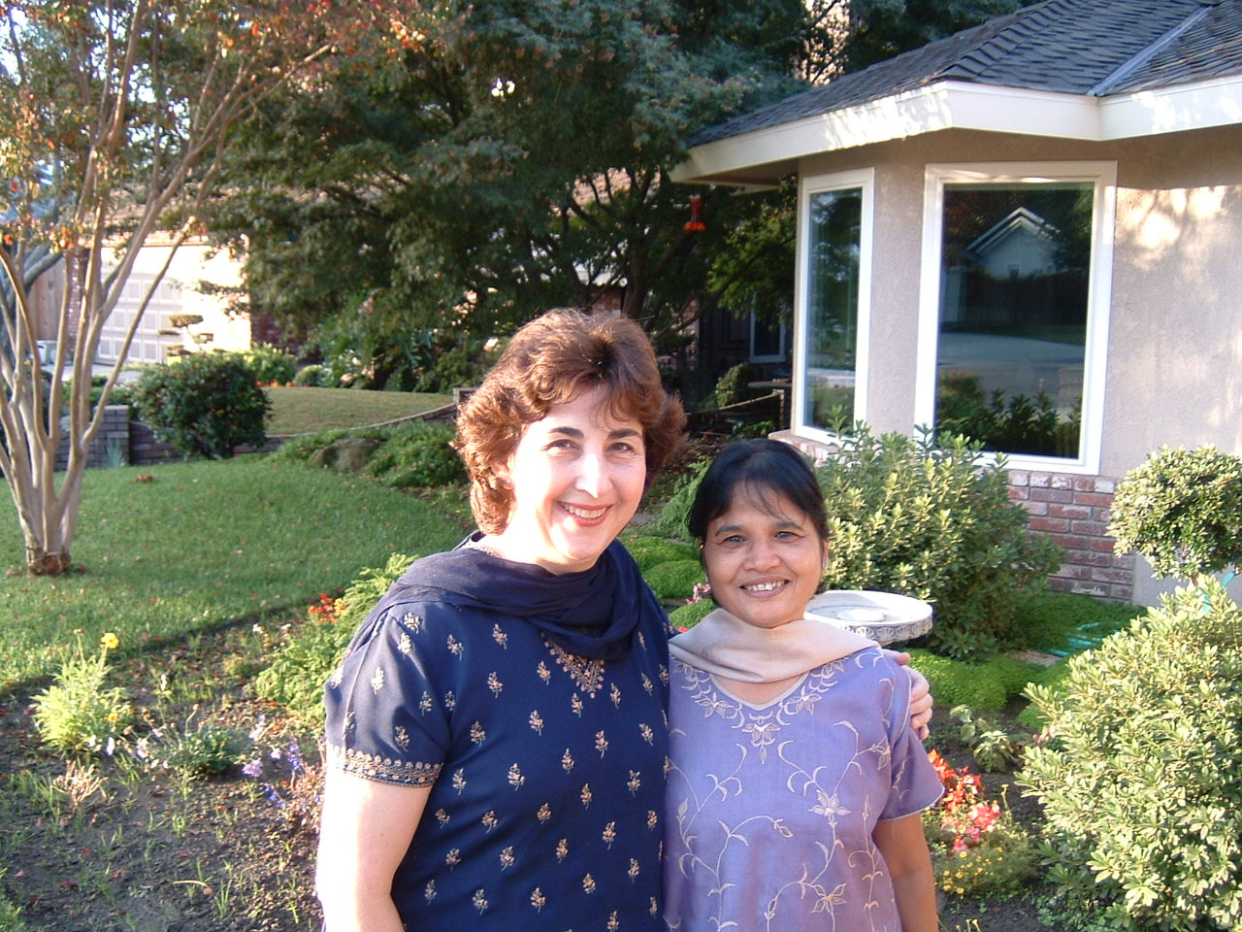
The Family Grows (Laurie in Visalia)

Slide 31
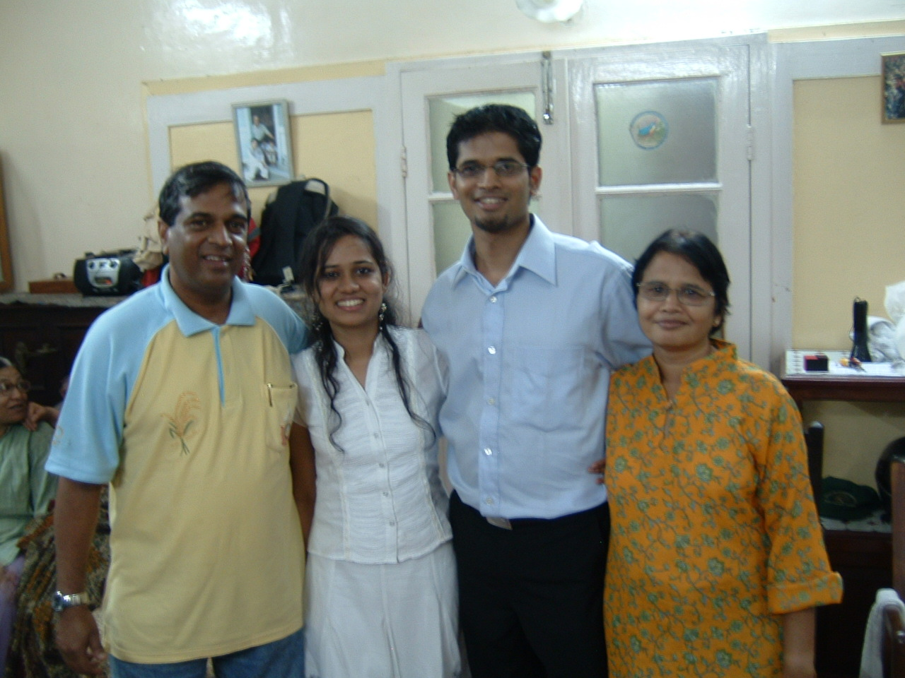
The Storm’s Over? (Big Relief, Stephen gets Engaged)

Slide 32
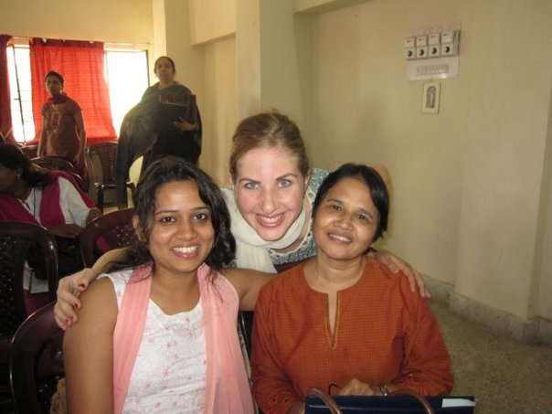
The Daughters I Never Had (Shanti and Pre-Stephen Smiley Arpita)

Slide 33
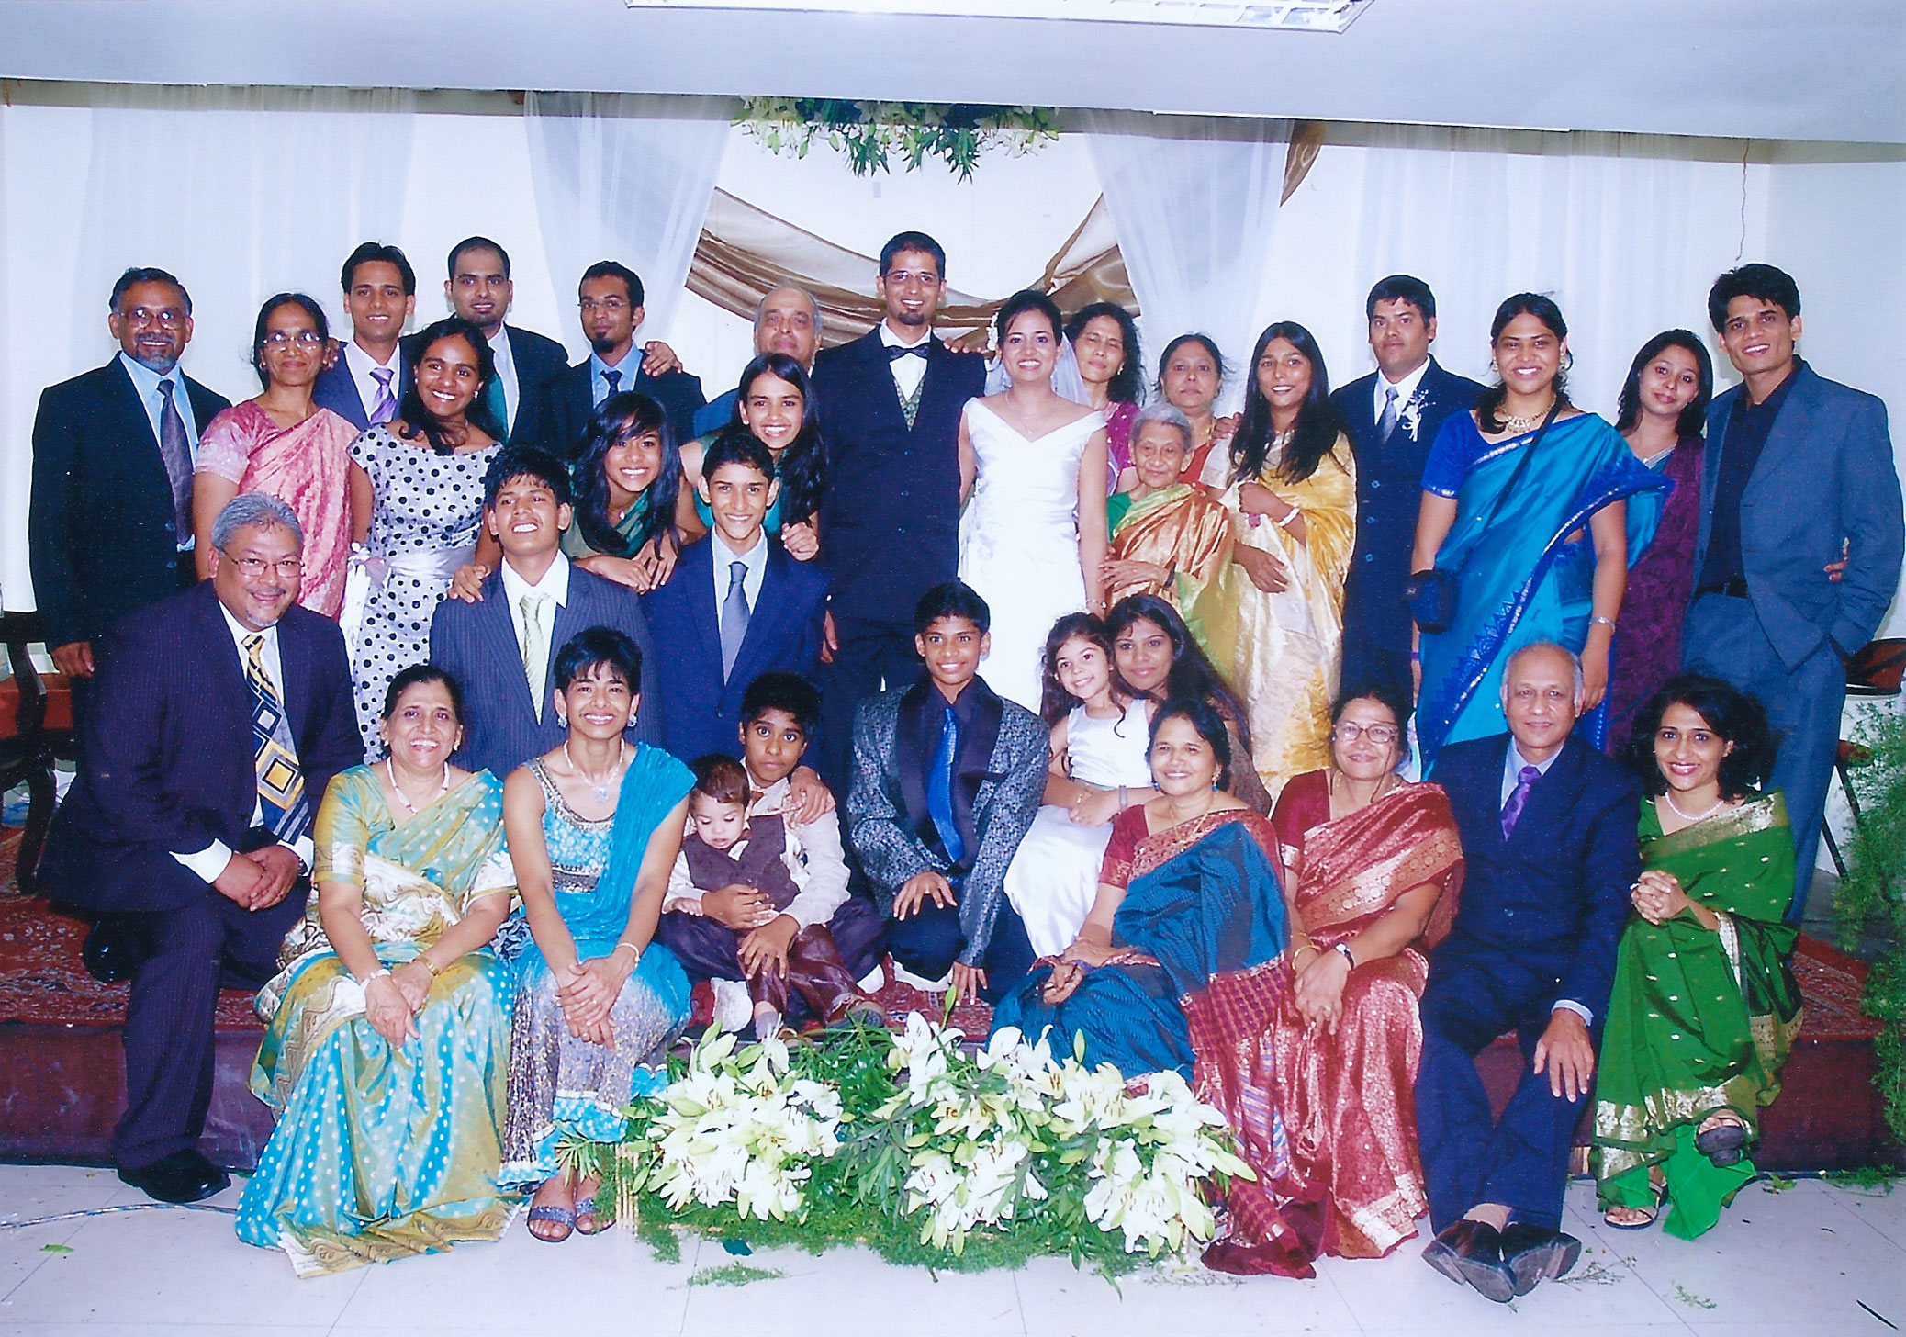
We’re All Related (Stephen & Arpita’s Wedding)

Slide 34
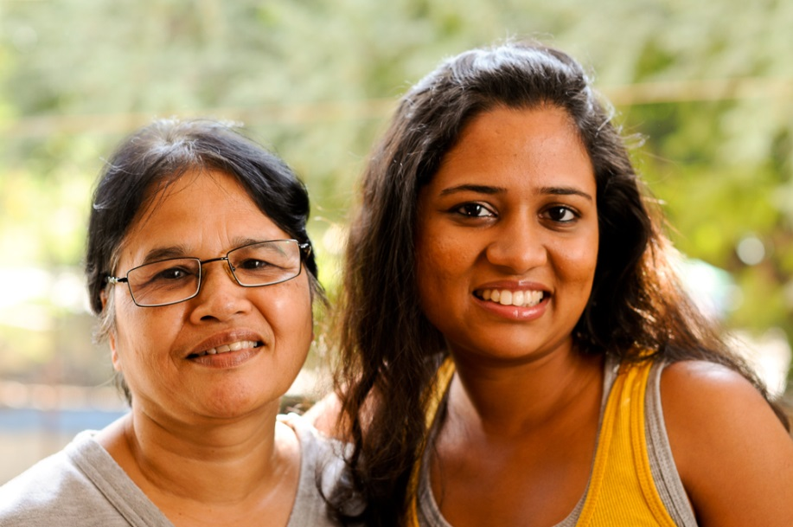
Daughter or Sister?

Slide 35
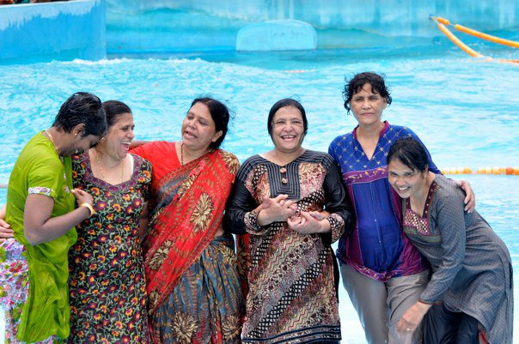
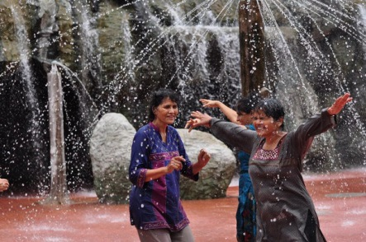
Senior Dance (Shalom’s Wedding)

Slide 36
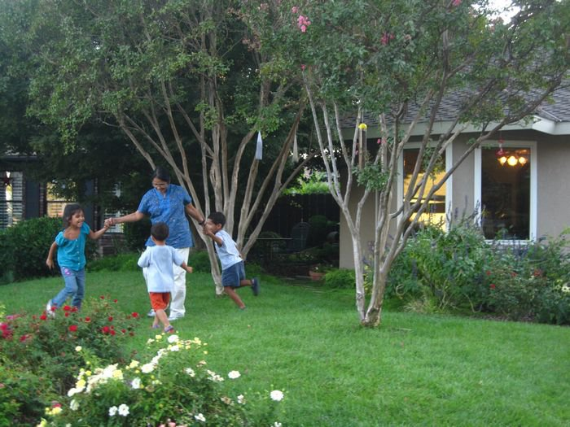
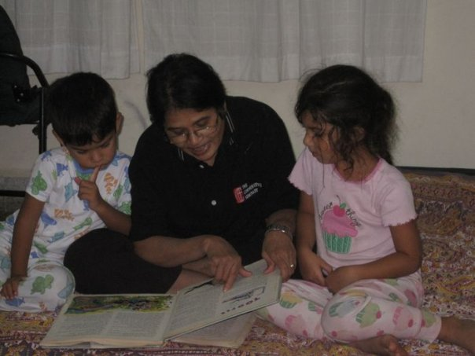
Happiness (Hannah, Caleb, Micah)

Slide 37
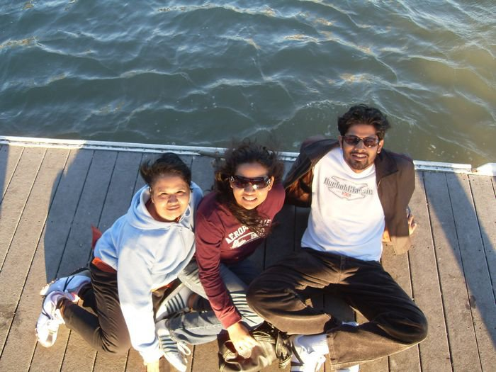
Happy to Waste Some Time (Sitting on the Dock of the Bay, San Francisco)

Slide 38
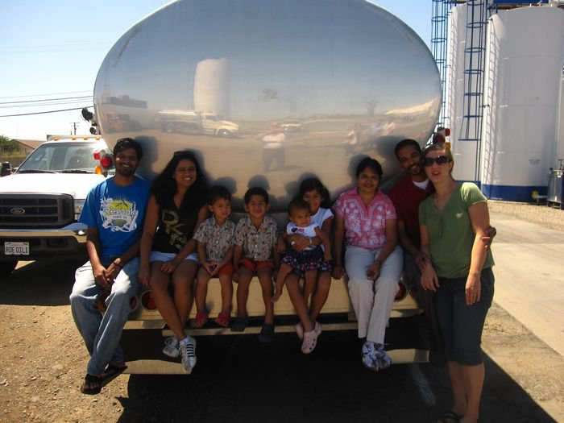
A Tank Full of JOY (Nicole’s Dad’s Workplace in Visalia)

Slide 39
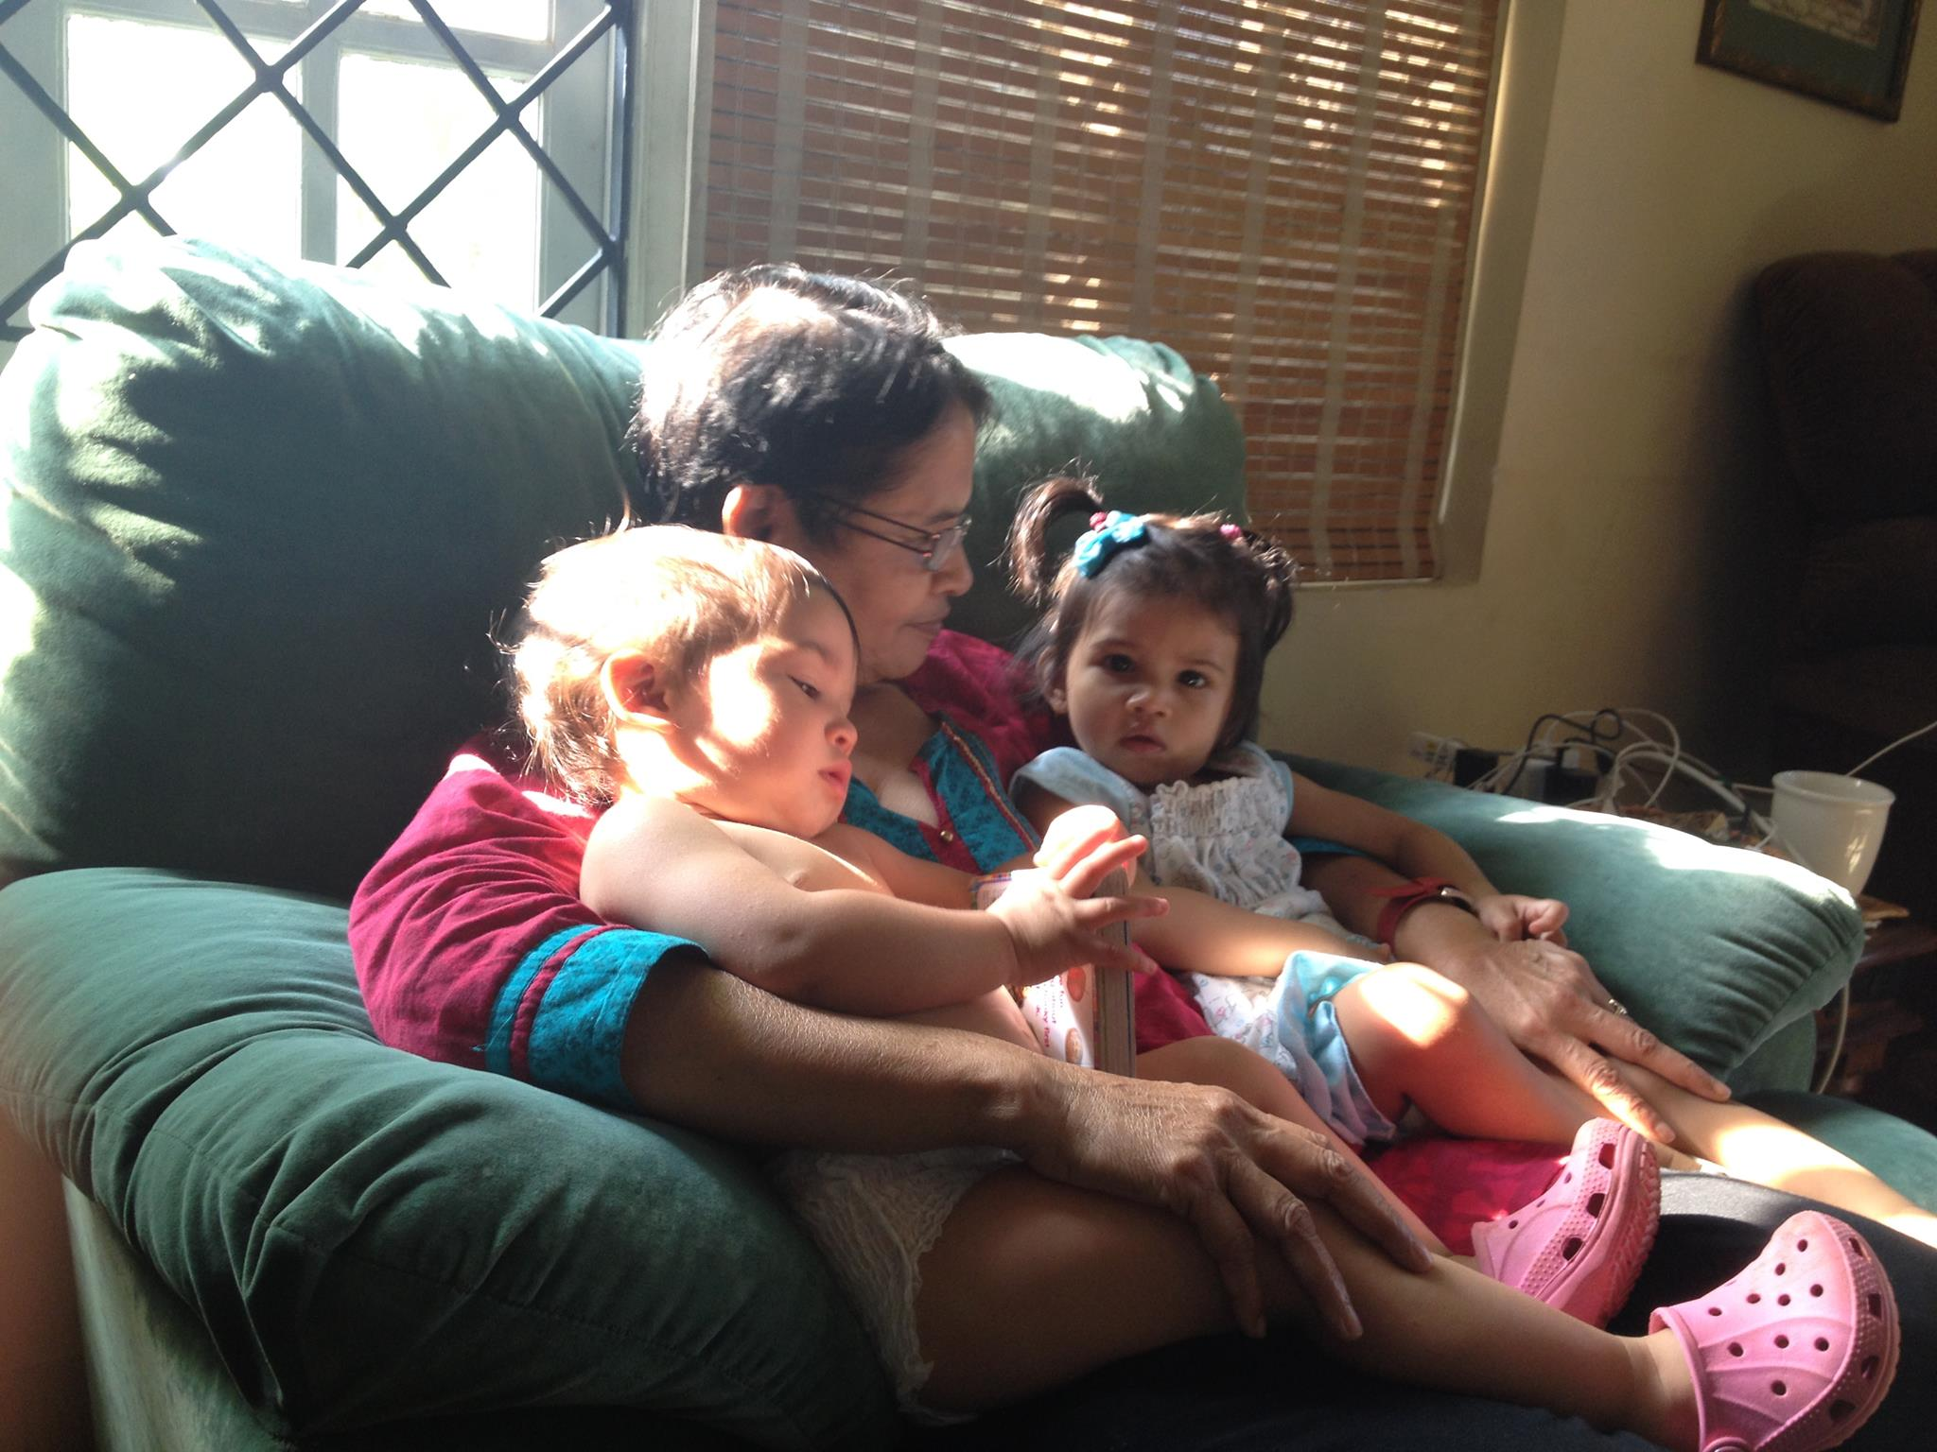
The Joy Doesn’t Stop (Abigail and Saige)

Slide 40
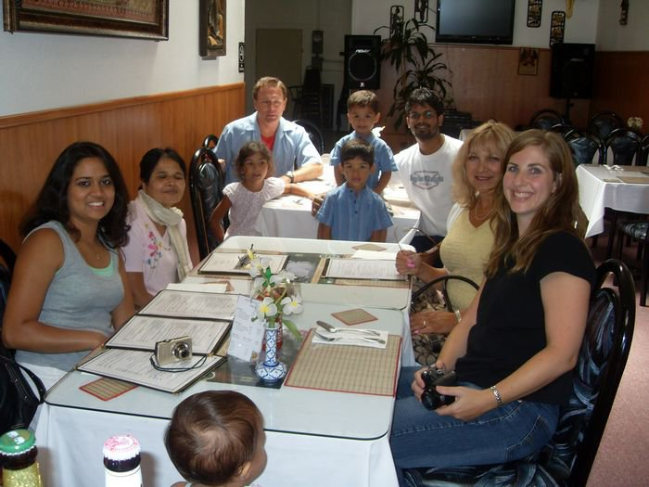
Life-Changing Relationships (With Steve and Karen in Vallejo)

Slide 41
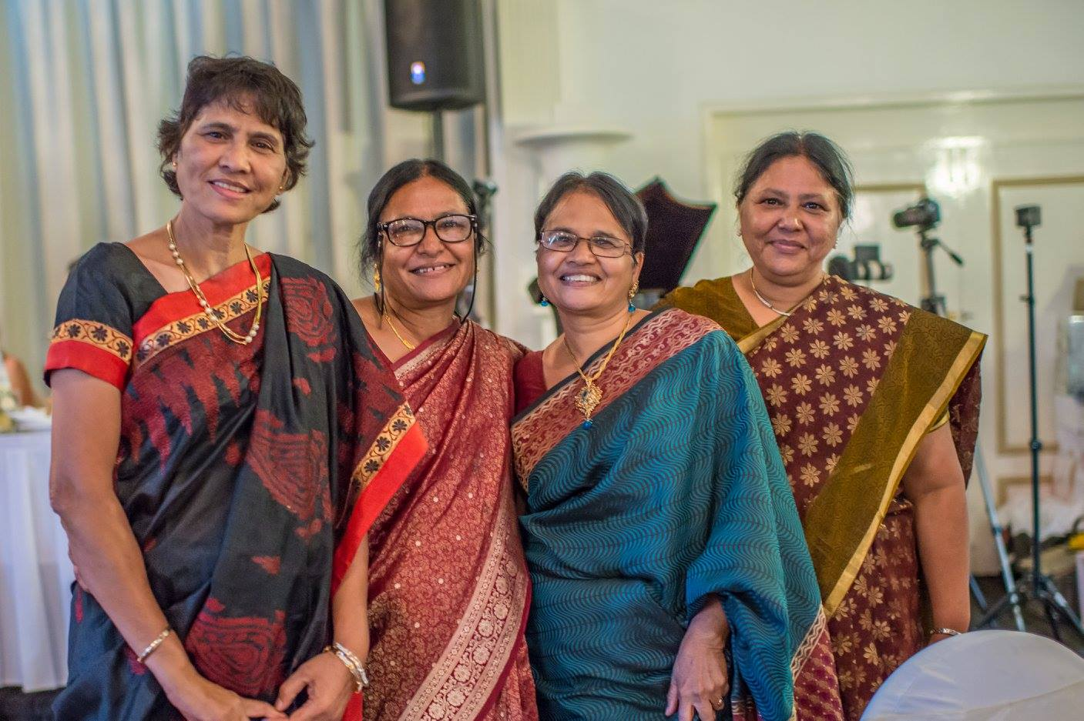
Still Beautiful (Saee’s Wedding)

Slide 42
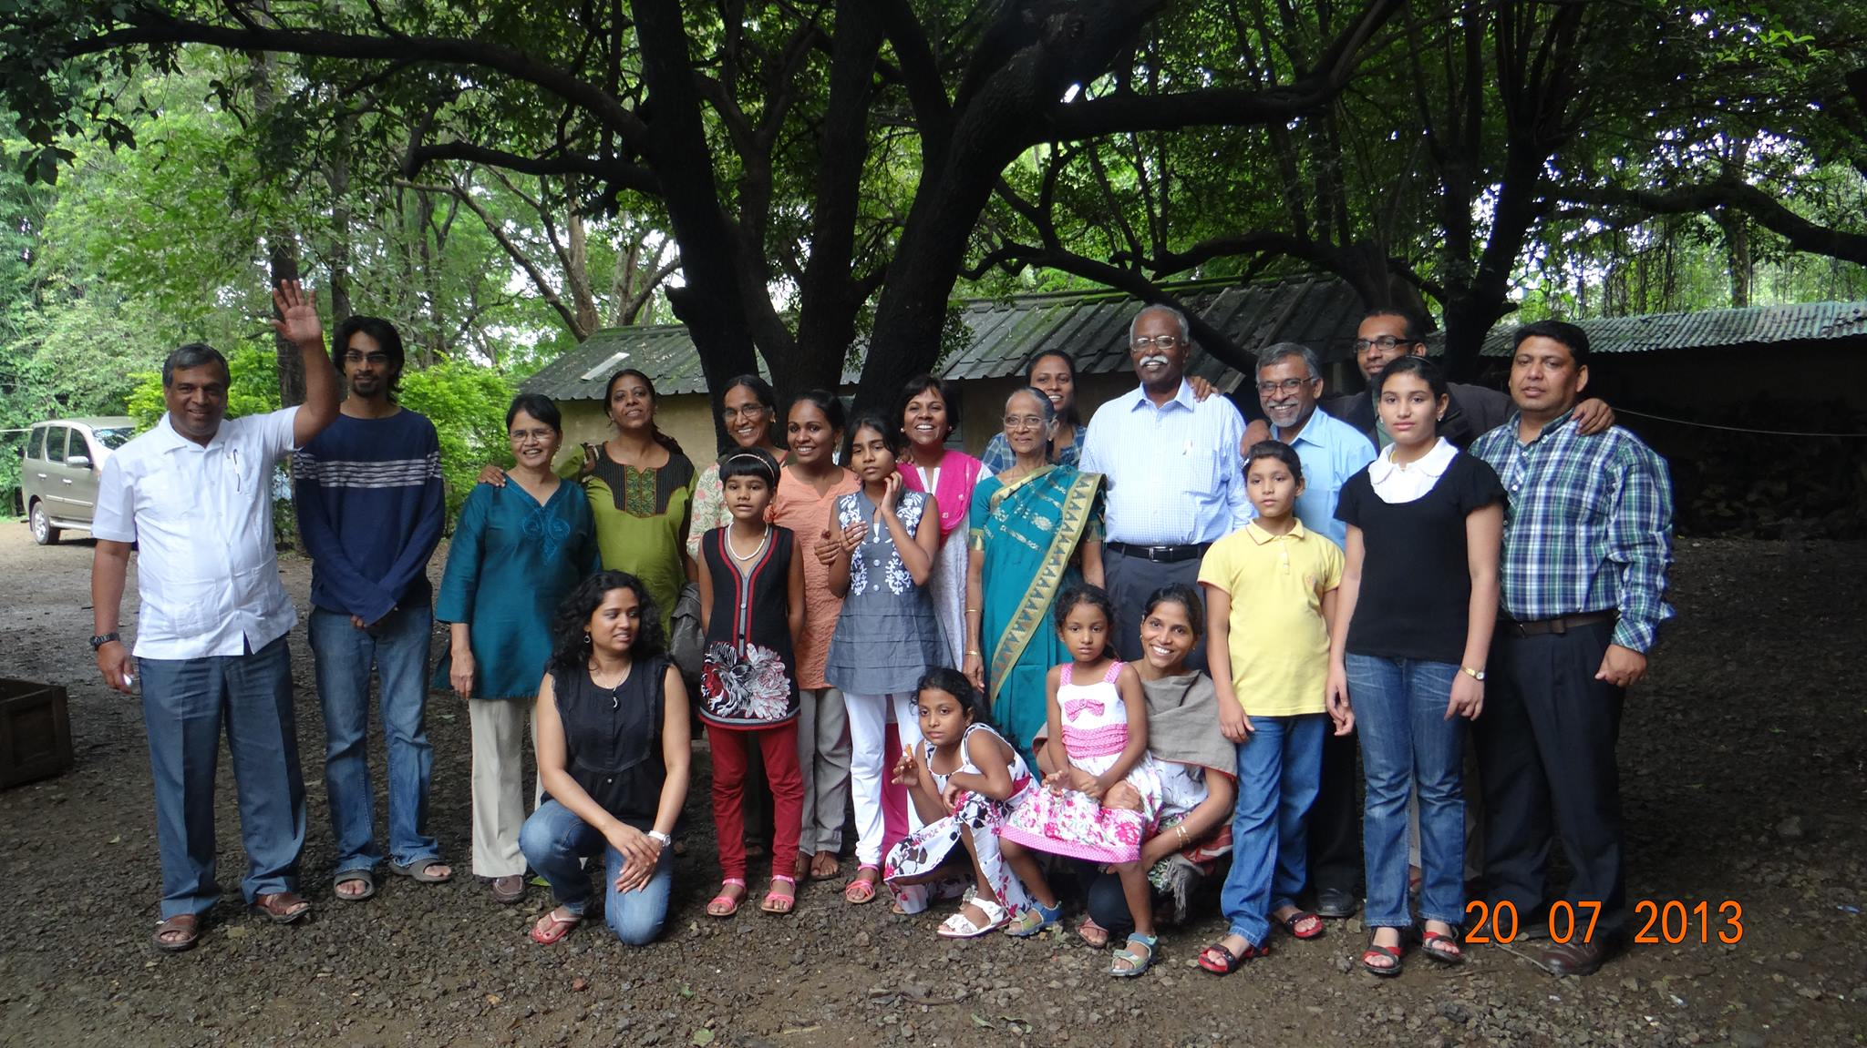
The Mighty Williams’ Family! (Reunion at Bible Center)

Slide 43
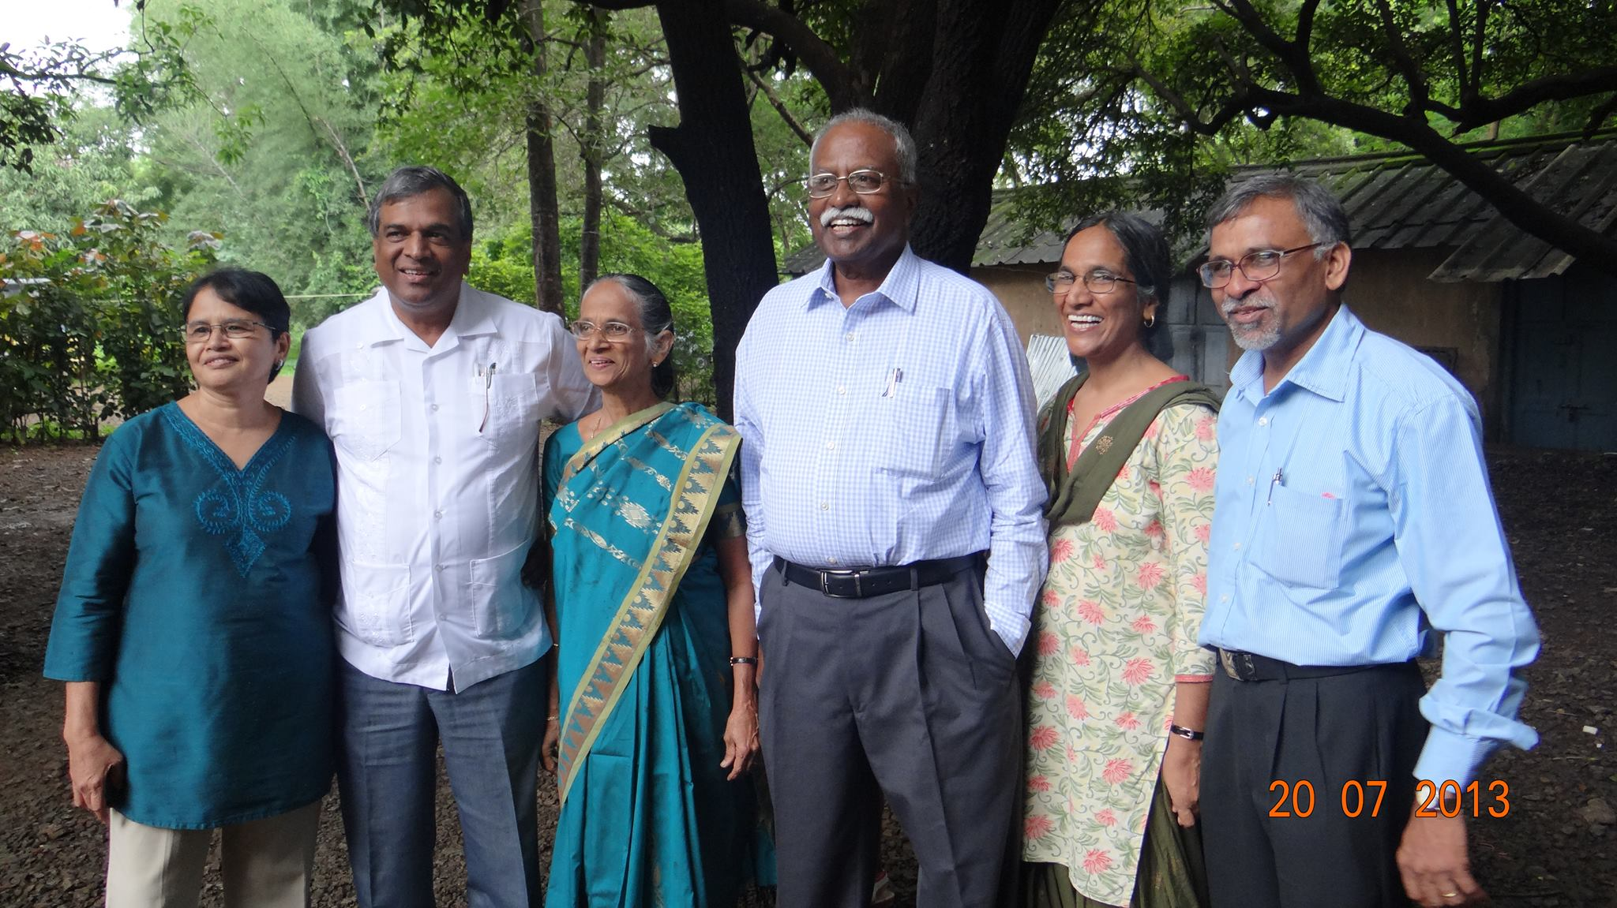
Frosted Flakes (Still full of energy)

Slide 44
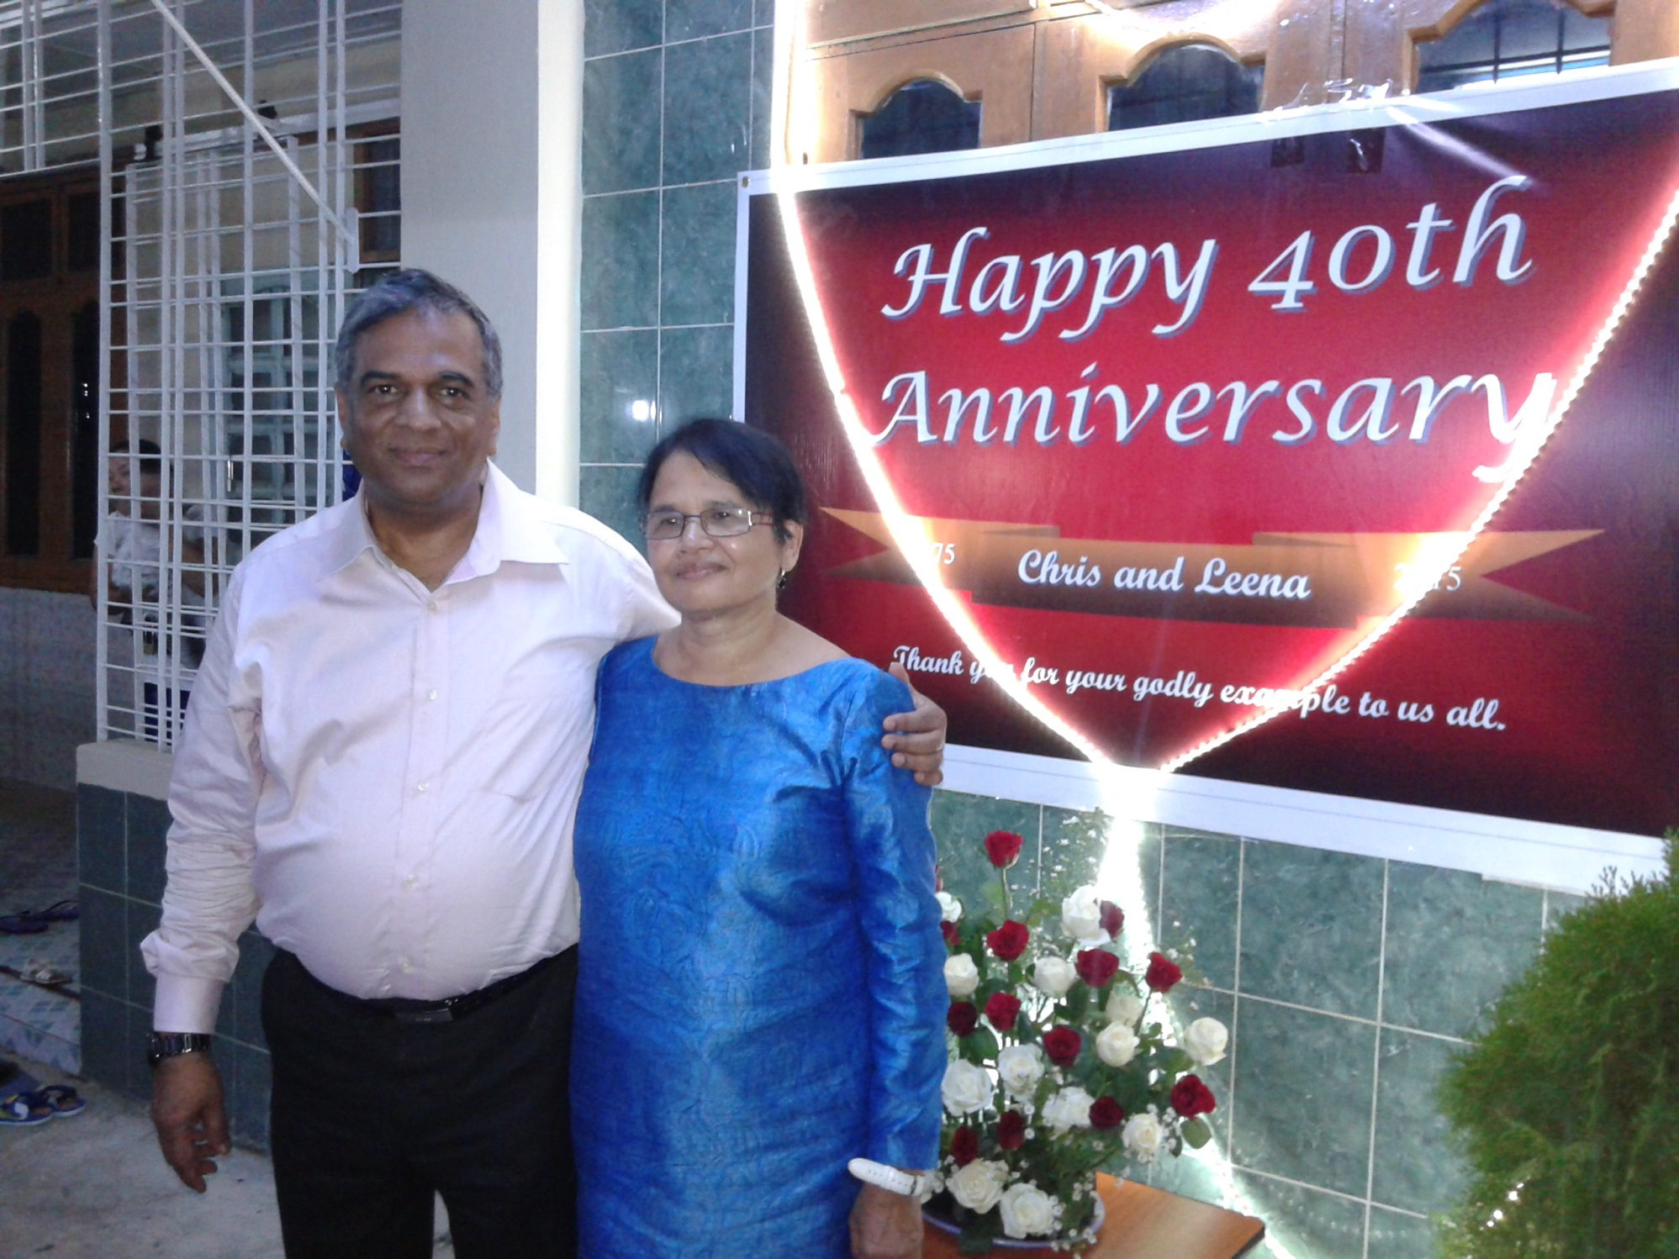
Thick and Thin (Thick is on the Left)

Slide 45
The Promised Land

Slide 46
A Well- Deserved Contentment

Slide 47
Stay Always Young! (because Fun Must Come)

